Slide 1



SDG Indexing Dashboard
- Jammu and Kashmir
Public Dashboard
User Manual v0.1
Velocity Software Solutions Pvt. Ltd.
Address: E23, Sector 63, Noida, UP, India 201 301
Ph: +91120424 3310
Email: inquiry@velsof.com
Web: www.velsof.com

Slide 2
Agenda
Introduction…………………………………………….……3
Landing Page……...…………………………………………4
Viewing J&K SDG Progress…………………….…………..6
Viewing J&K District wise SDG Progress.……………….....9
Comparison on India Index………………..………………..19
Viewing of OOMF Page….....................................................24
Viewing of Analysis & Interpretation Tab..…………………26
Viewing of NITI Aayog Page..……………………………...29
Other Page Navigation..……………………………………..31

Slide 3
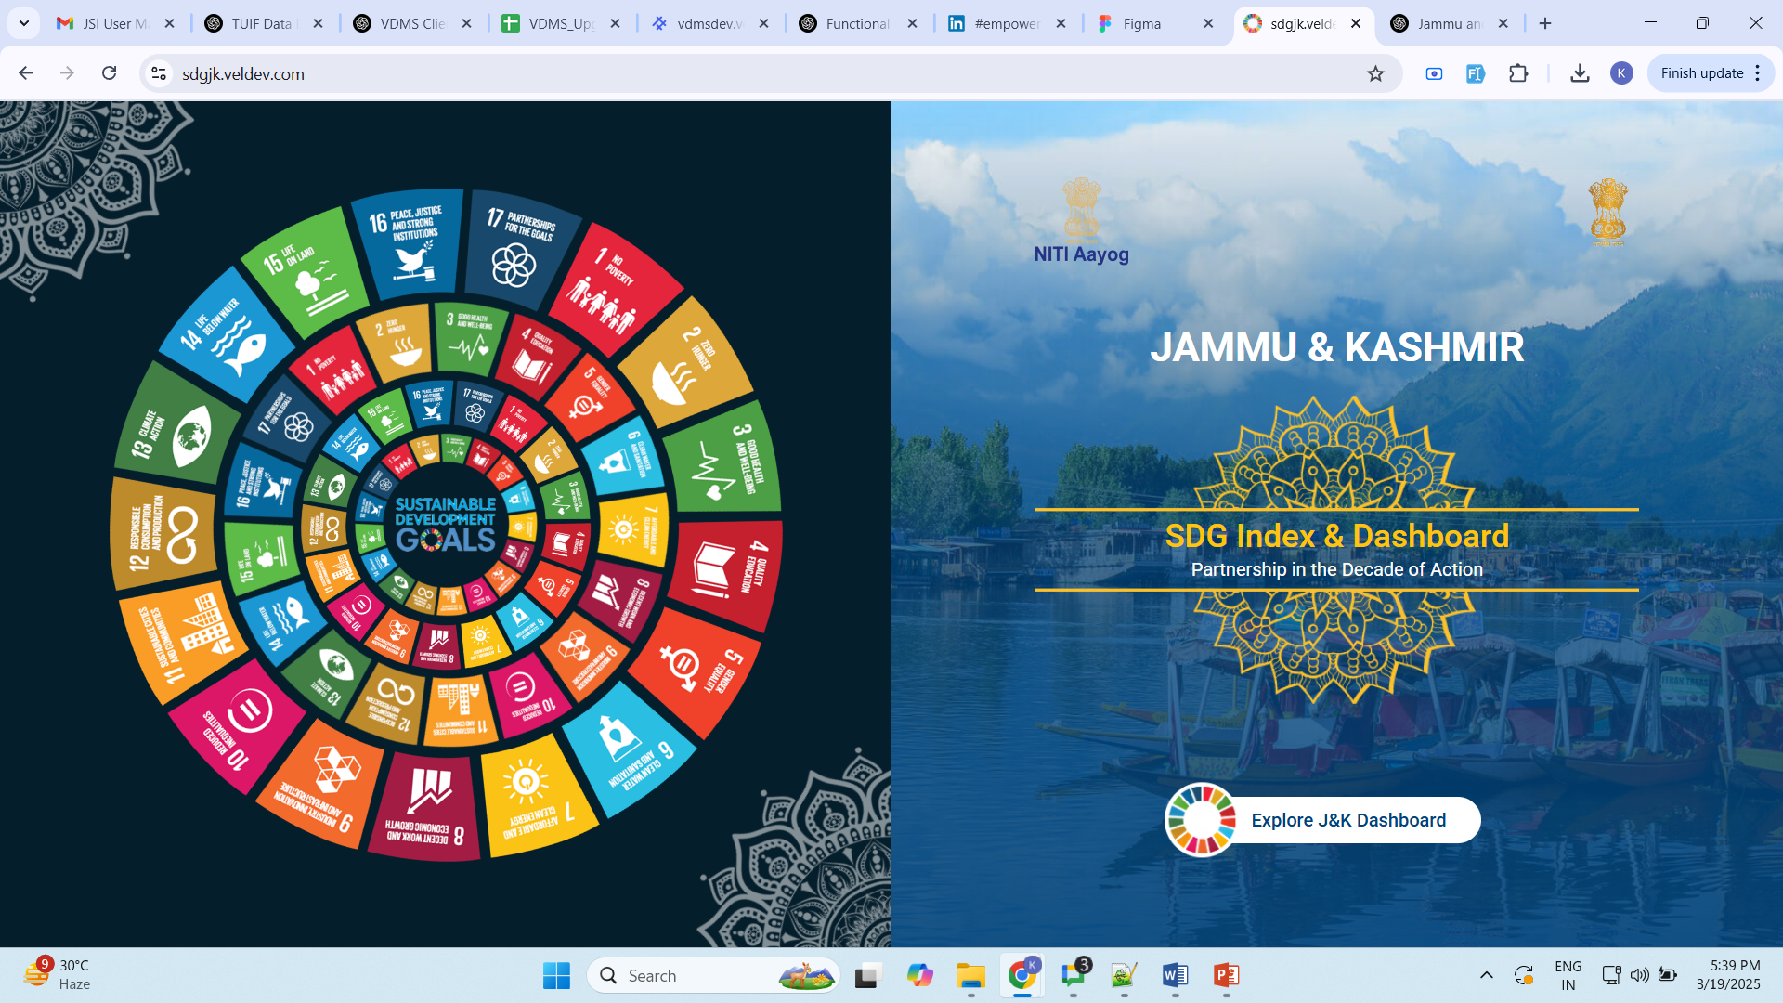
Introduction
The Jammu and Kashmir SDG Dashboard is a web-based platform for storing, tracking, monitoring, and reporting state-specific Sustainable Development Goals (SDGs) indicators. It enables to track SDG progress at various administrative levels, ensuring comprehensive reporting on achievements related to SDGs.
The dashboard comprises two components:
  Public Dashboard for transparent access to SDG progress.
  User Dashboard with detailed insights for authorized users.

Slide 4
1. Landing Page

Slide 5
Landing Page of the J&K Dashboard.
Click here to view the SDG J&K Dashboard.

Slide 6
2. Viewing J&K SDG Progress

Slide 7
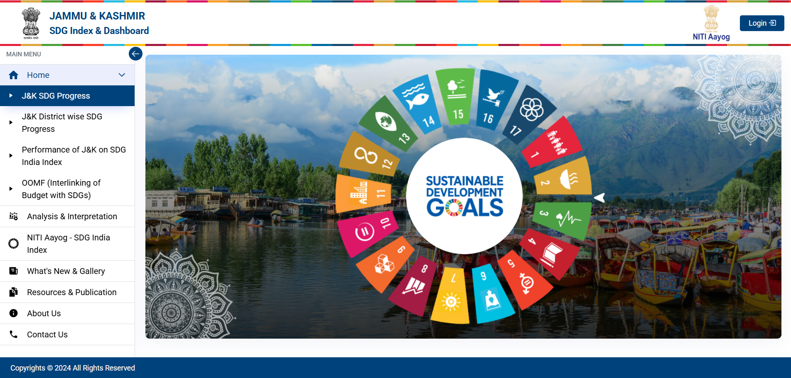
Step 1- Click on any goal icon to view the UT wise Progress of that goal.
Click here to view Performance of J&K for this goal.

Slide 8
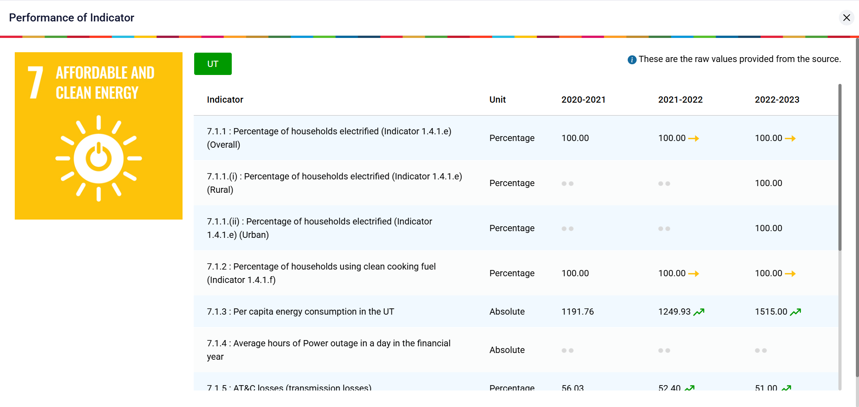
Step 2 - Displays the Performance of J&K for Goal 7.

Slide 9
3. Viewing of J&K District wise SDG Progress

Slide 10
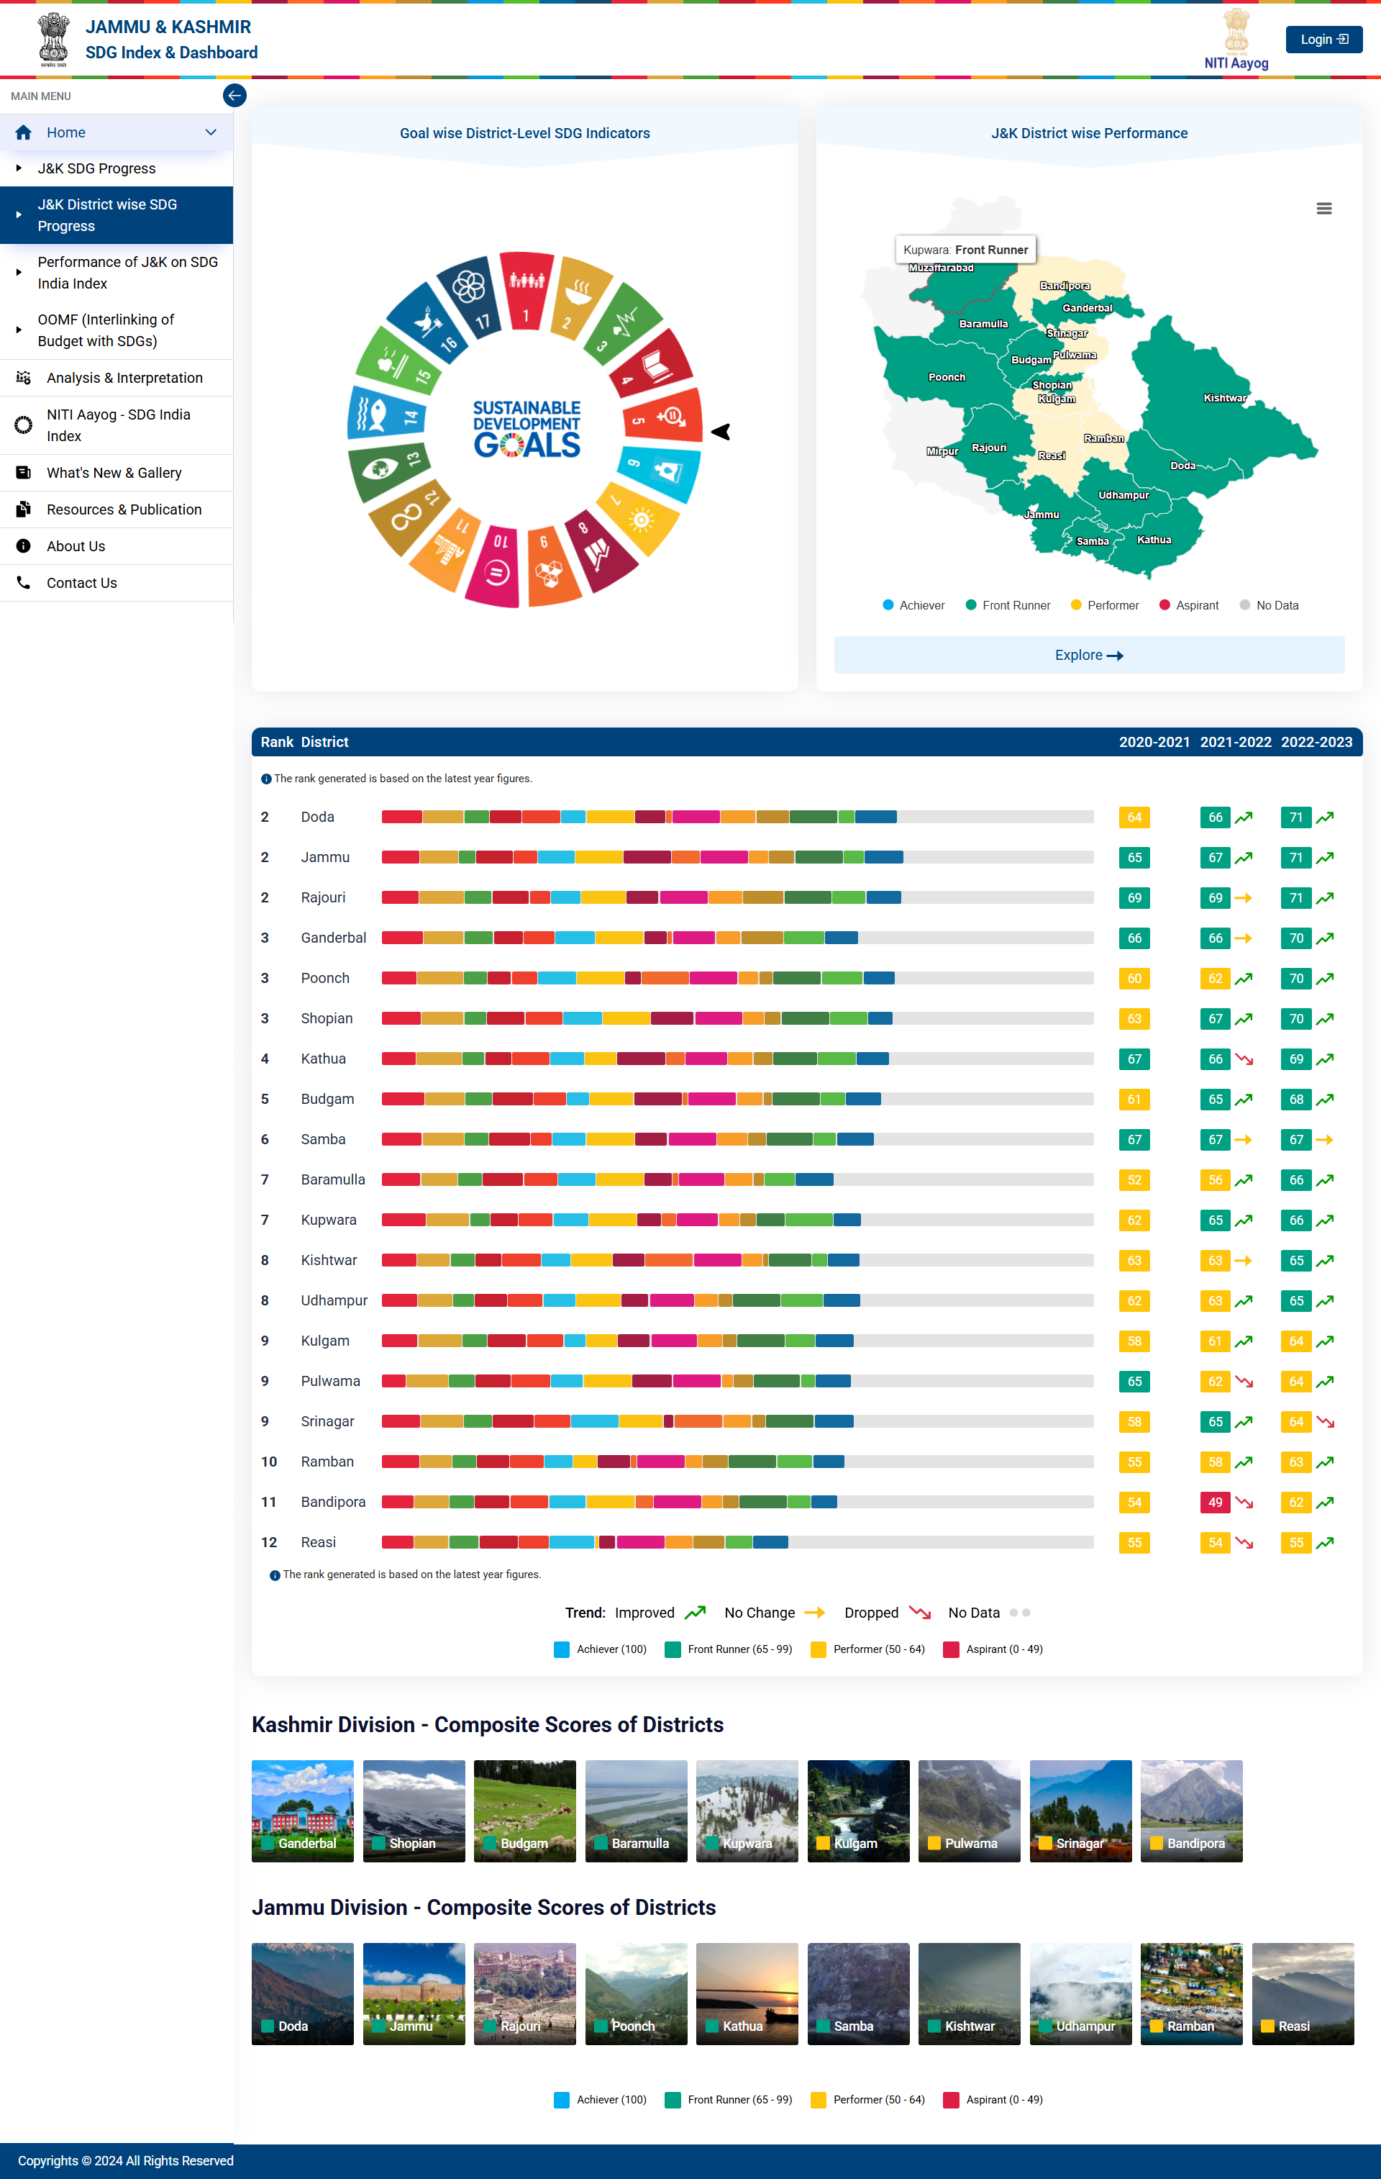
J&K District wise SDG Progress – Dashboard View.

Slide 11
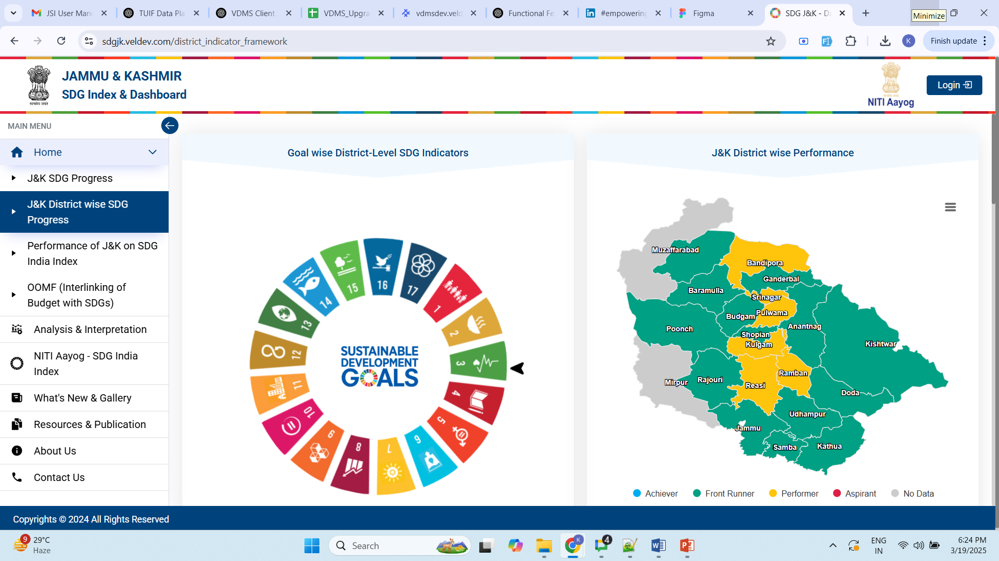
Step 1 - Click on any goal in the SDG wheel to view district wise score for that goal.
Click here to view Goal wise District Score.

Slide 12
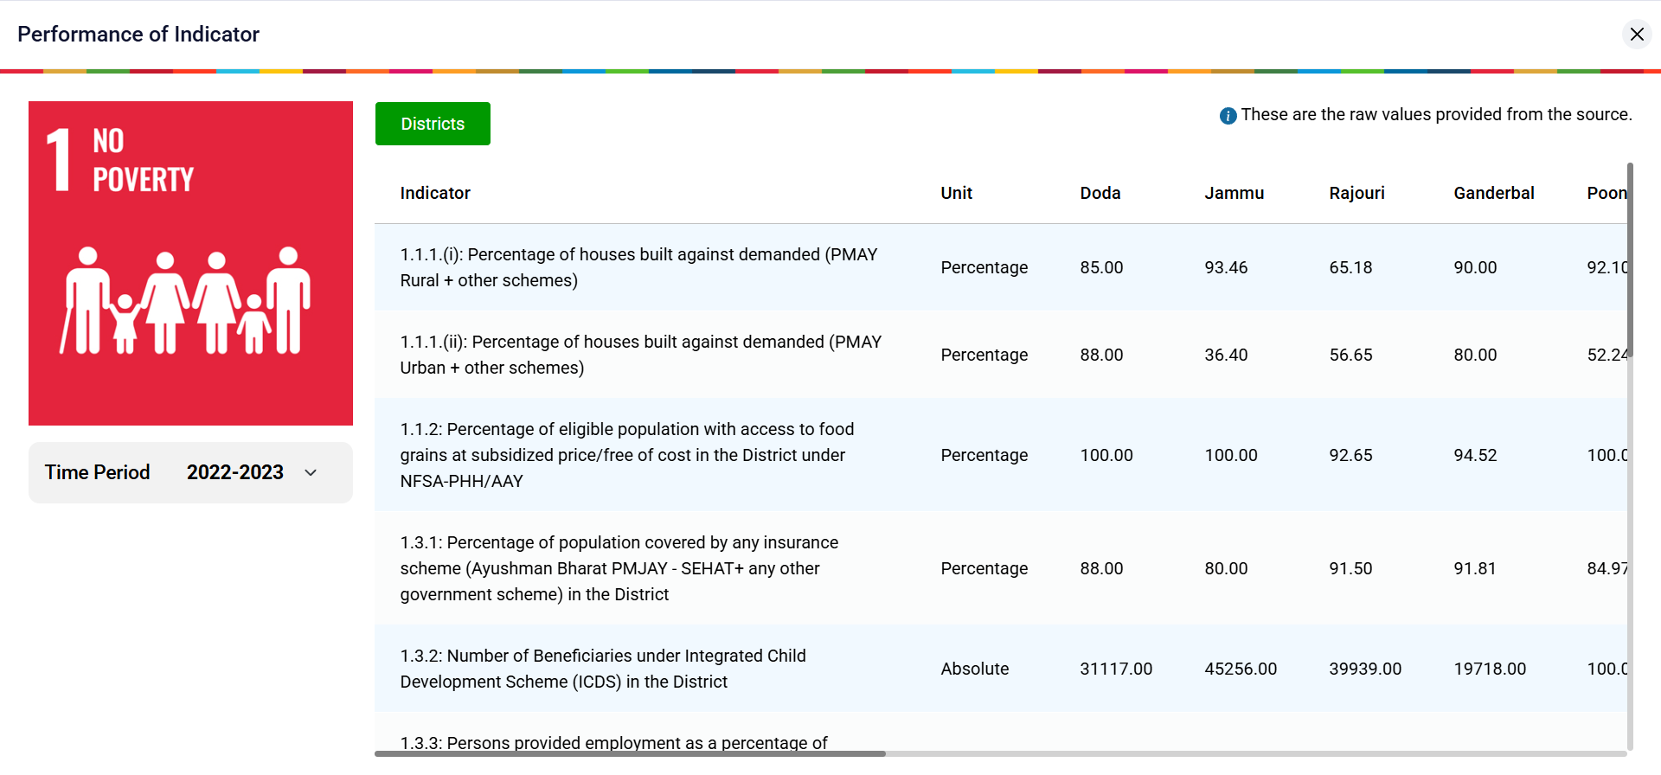
Step 2 - Displays the District wise Performance for Goal 1 .
Change the Year from here.

Slide 13
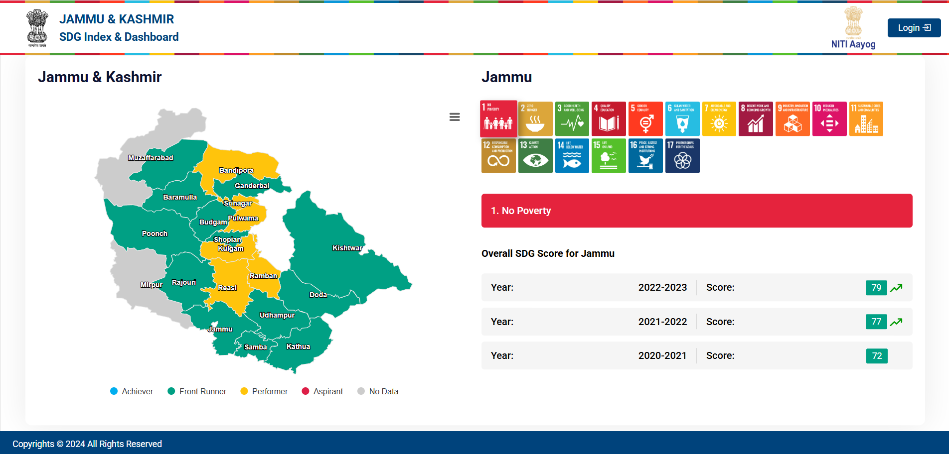
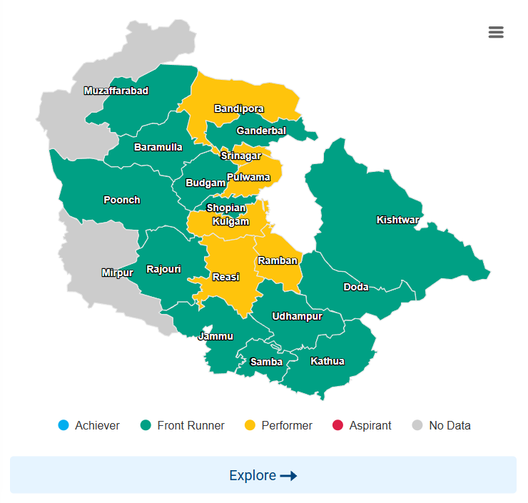
Step 1 - Click on the Explore button view overall SDG scores of all districts. You can click on any district or goal to display it’s last 3 years score.
Note - By default, No Poverty data of Anantnag district will be shown.
On click of any district, the detail of that district will be shown in the right side.

Slide 14
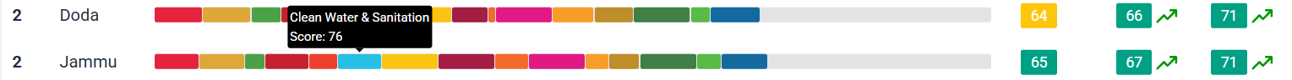
Step 1 - Scroll to view the Ranking of the Districts.
Click of any district’s score to view the Indicator Classification.
Hover to view Goal Score.

Slide 15
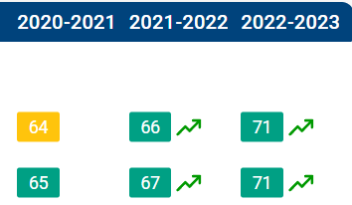
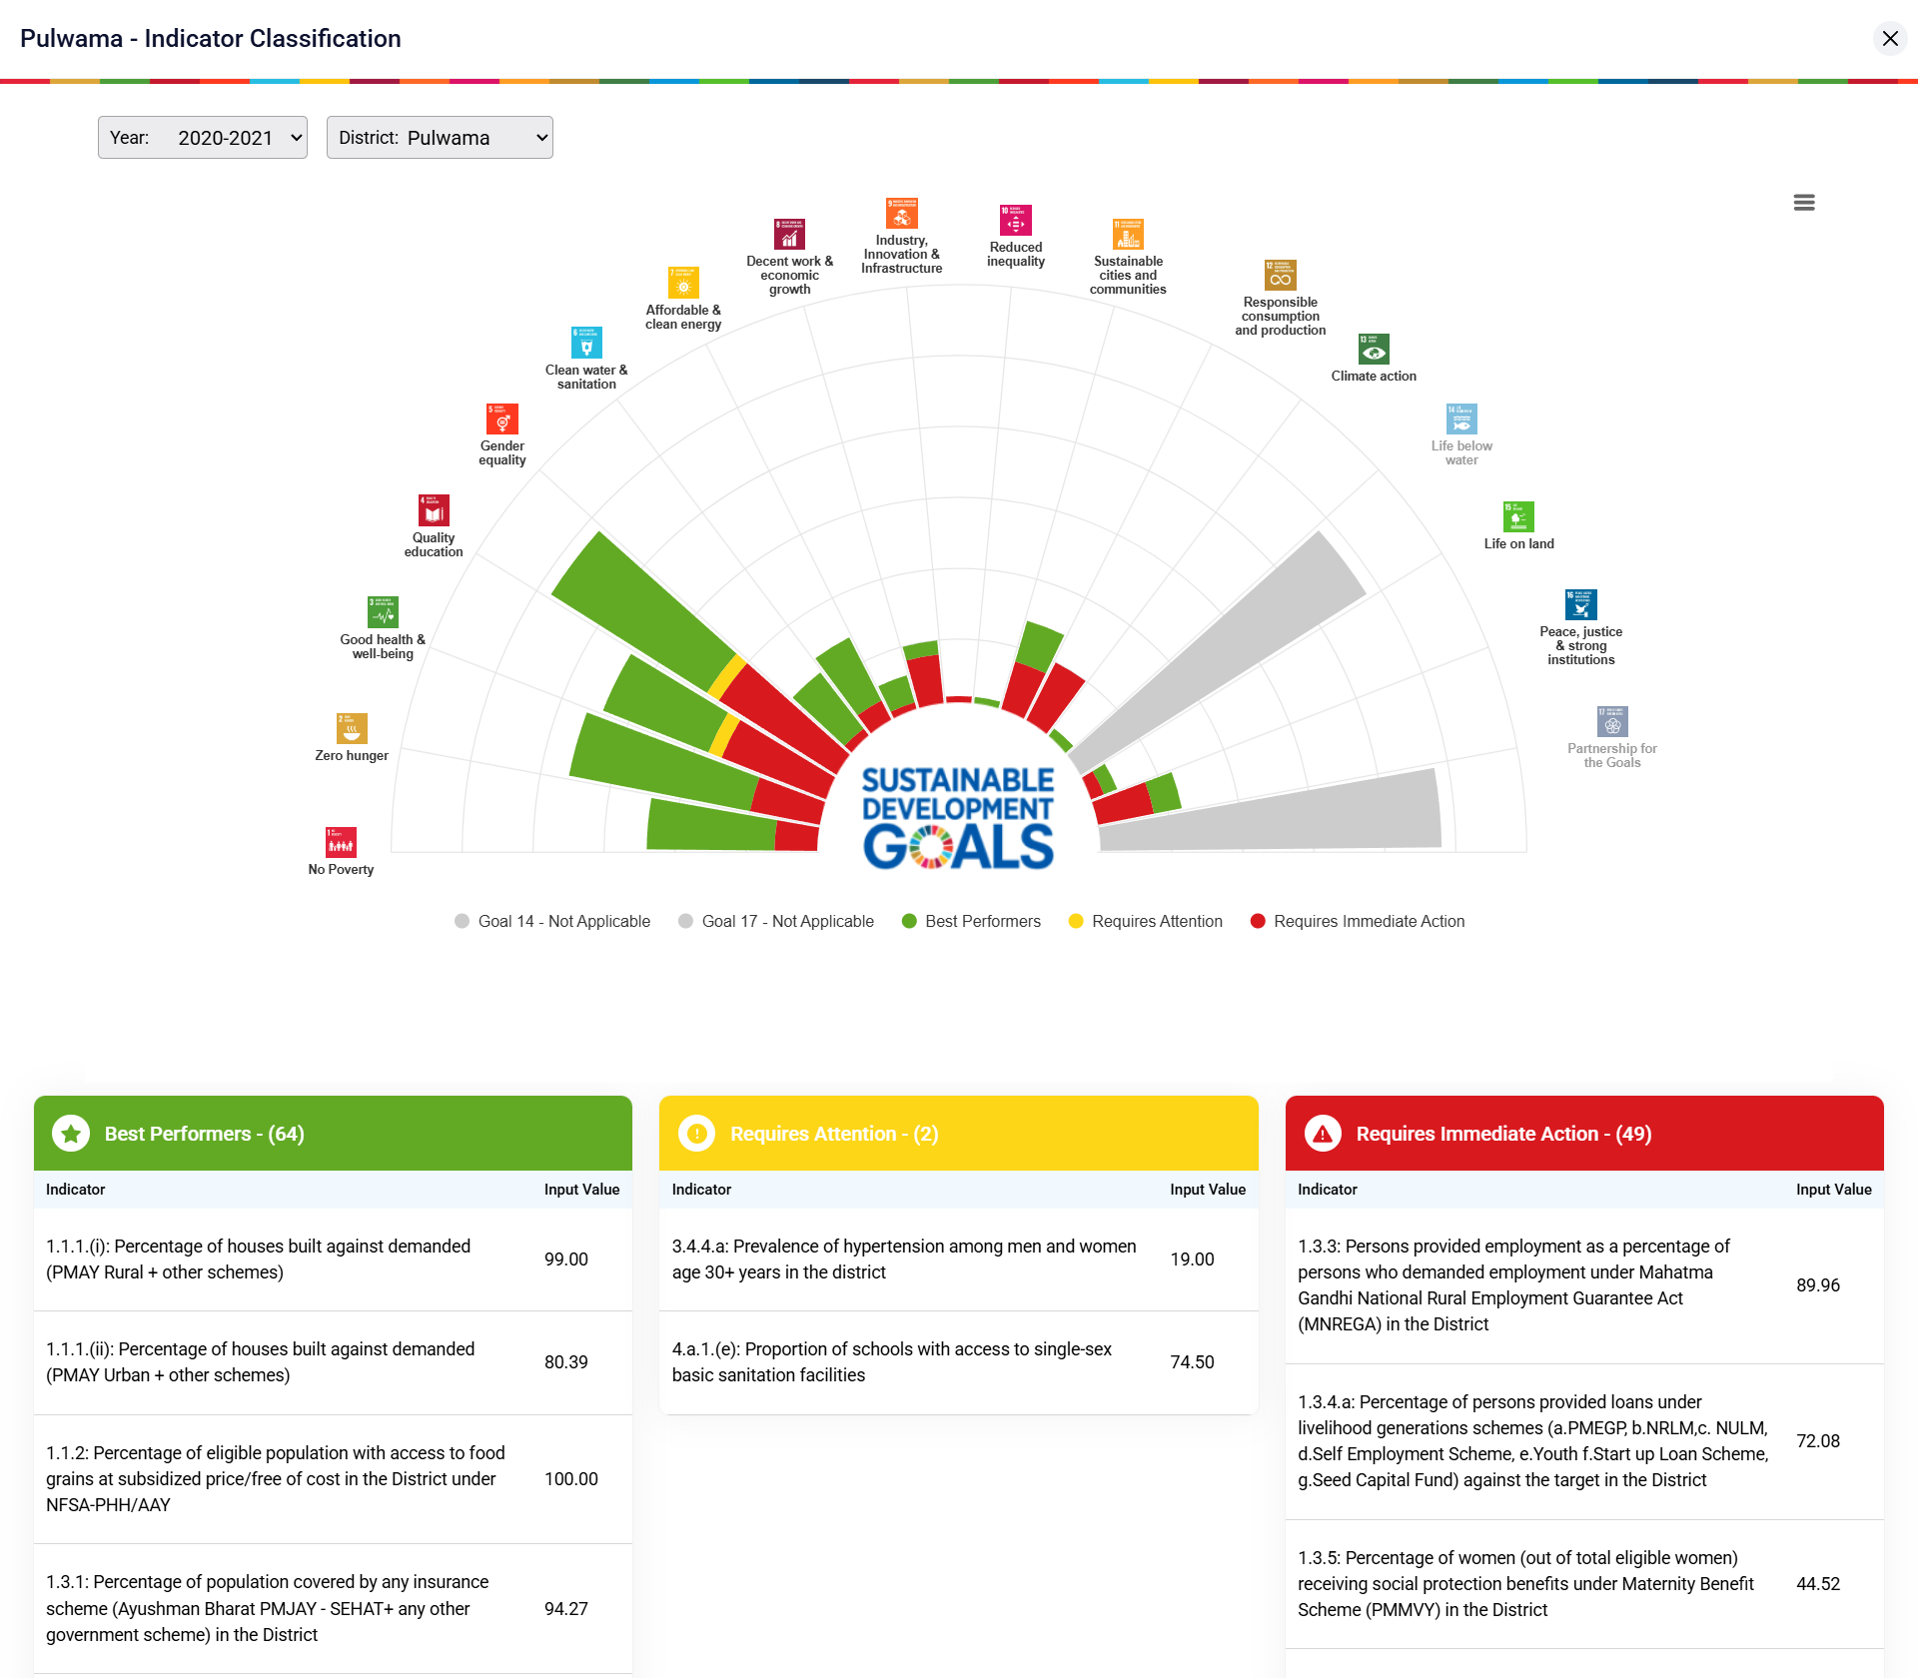
Step 2 - Click on the District Score to view the Indicator Classification.

Slide 16
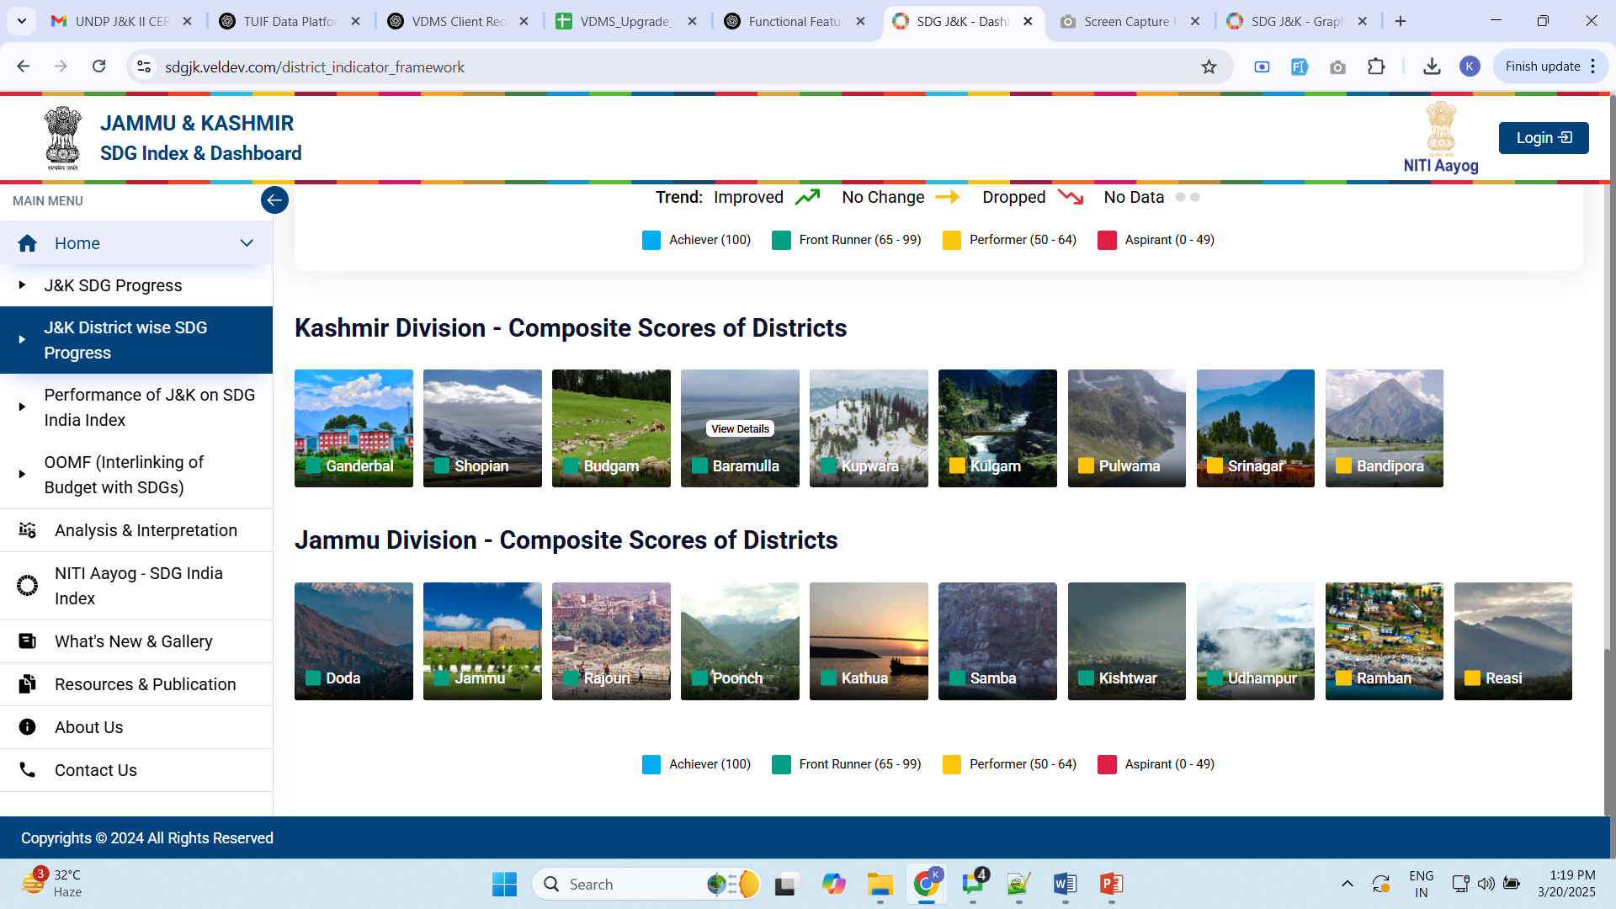
Step 1- Scroll to view Jammu & Kashmir Division District’s composite scores.
Click on the district icon for detailed view.
The color displays the SDG score category of the district.

Slide 17
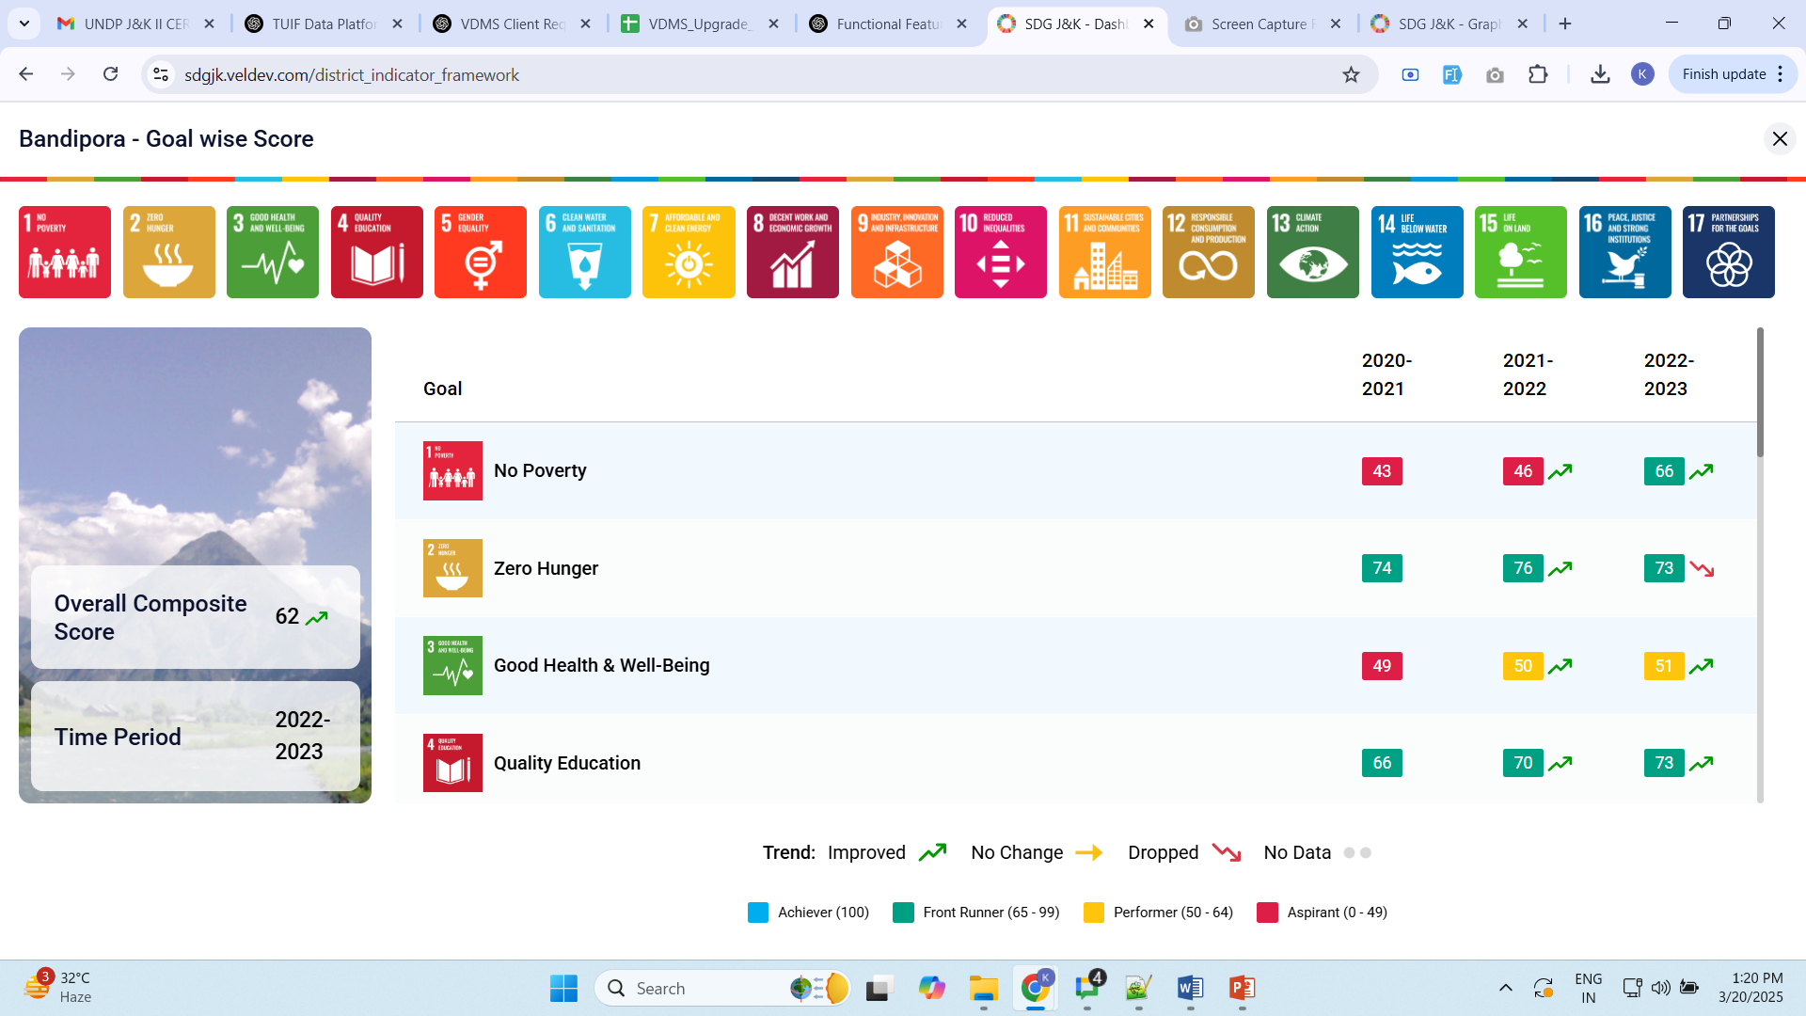
Click on the District icon to view this screen.

Slide 18
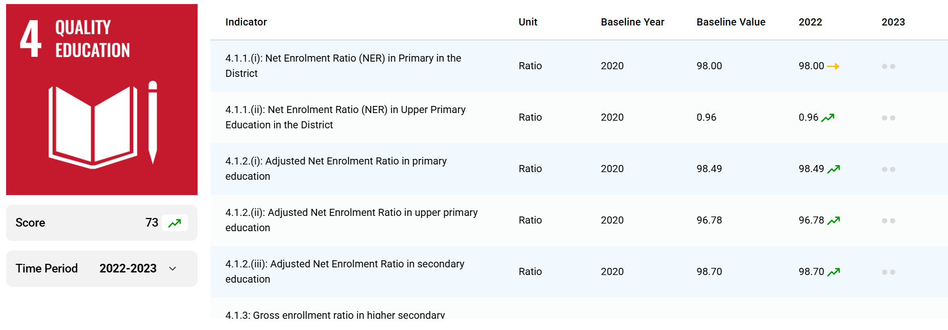
Step - 2 Click on the goal name or icon to view Performance of Indicator pop-up.

Slide 19
4. Viewing of Performance of J&K on SDG India Index

Slide 20
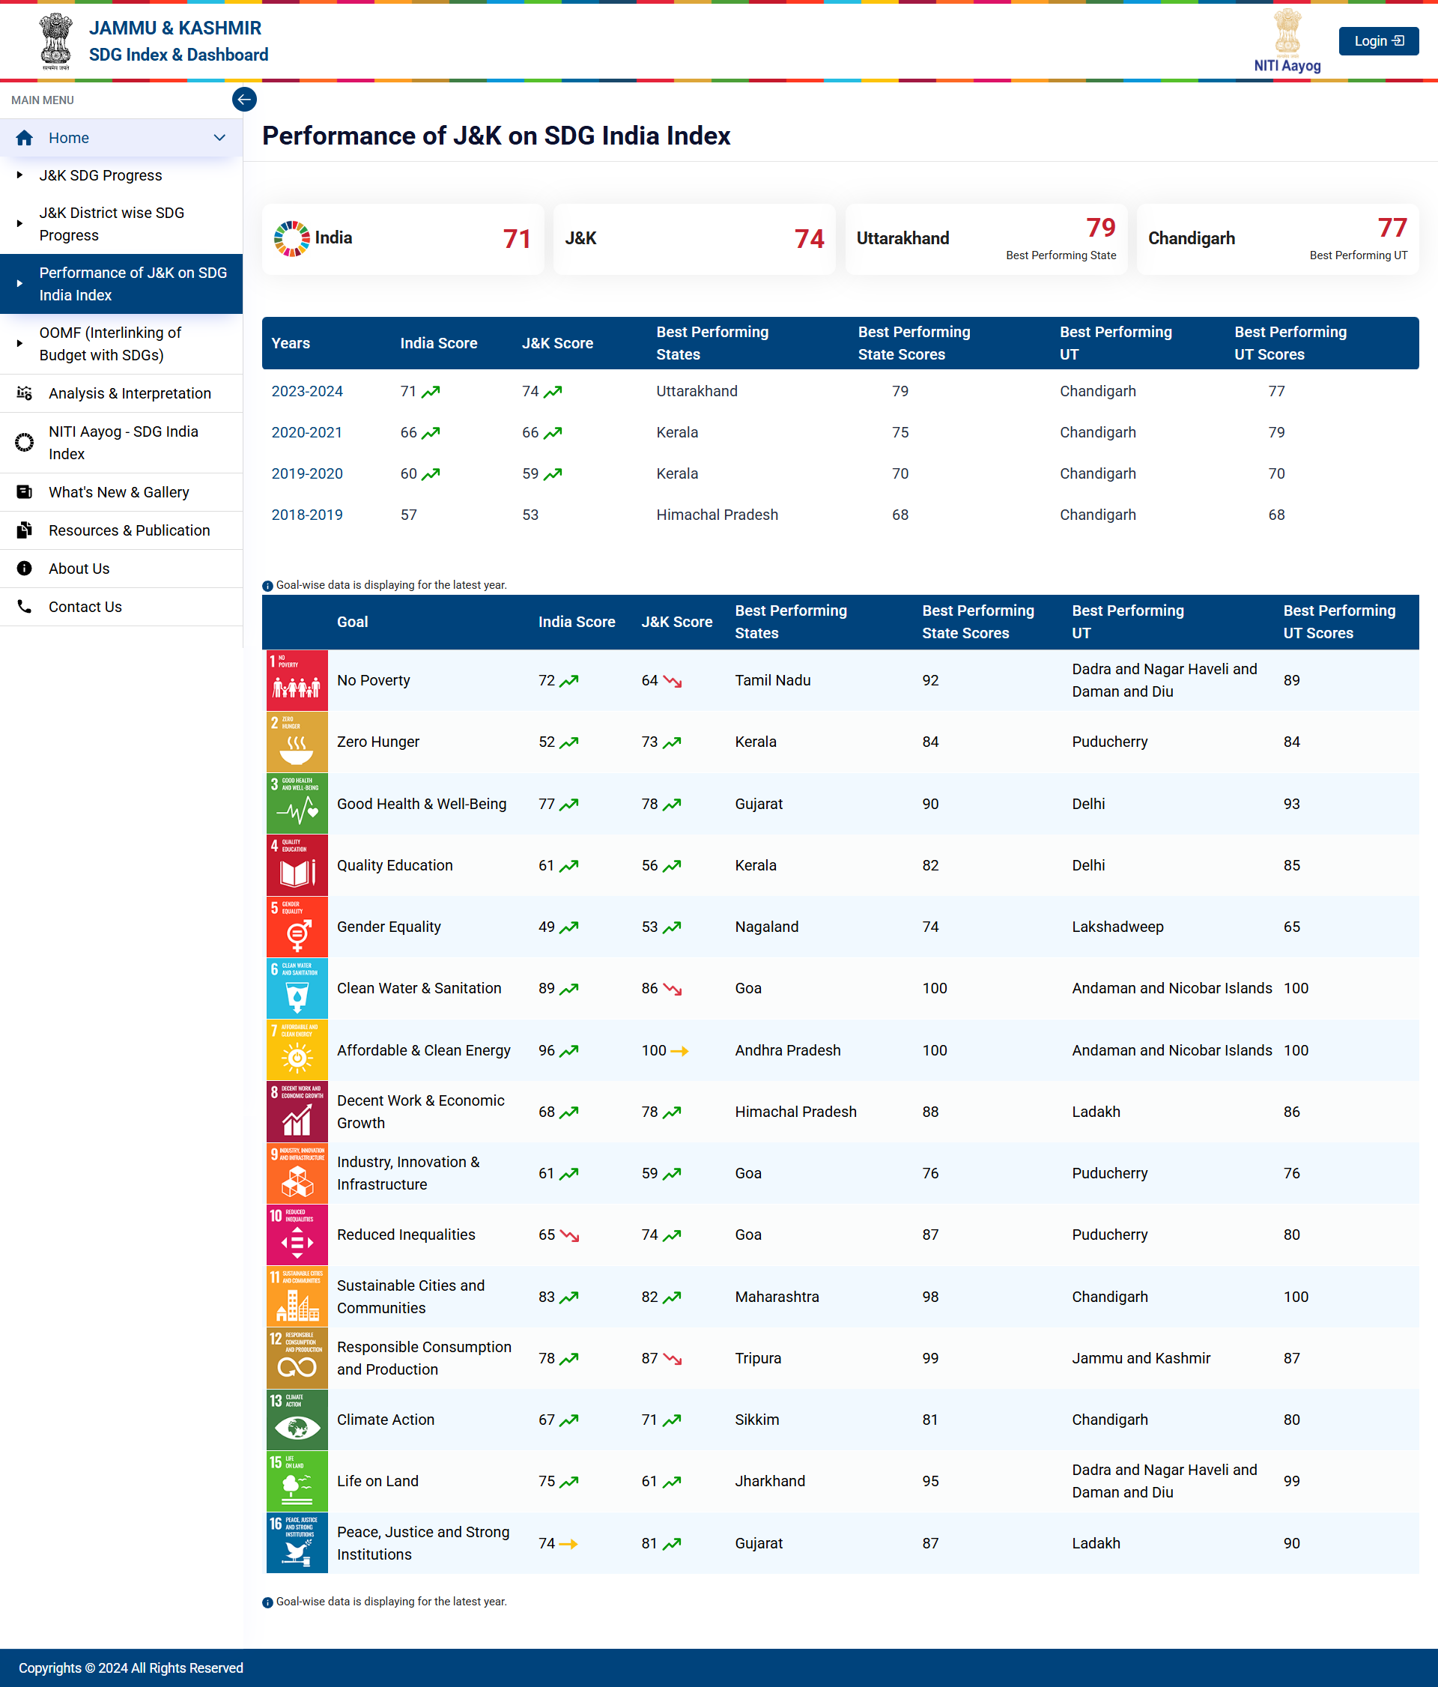
The SDG wheel displaying the state CIF score for each goal and year as default.

Slide 21
Displaying comparison of the J&K performance on SDG India Index.
Cards displaying the data for Current Year.
Click on the Year to view Overall Comparison of this year.

Slide 22
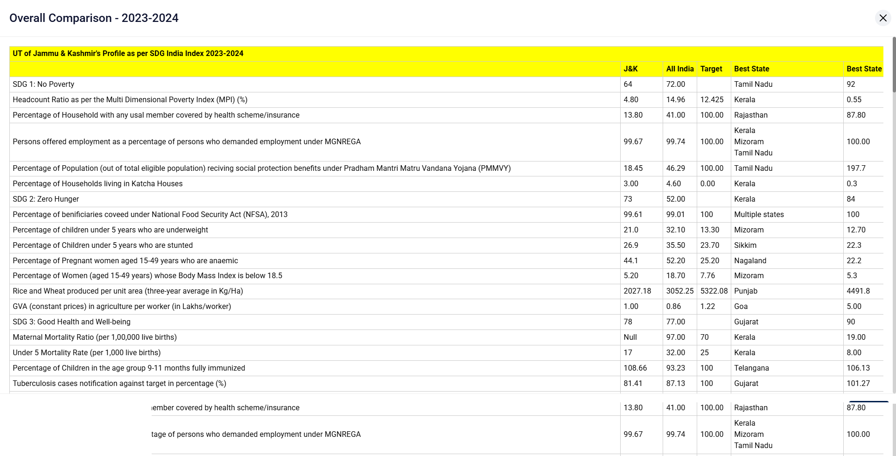
Click on the year to view the Overall Comparison of that year.

Slide 23
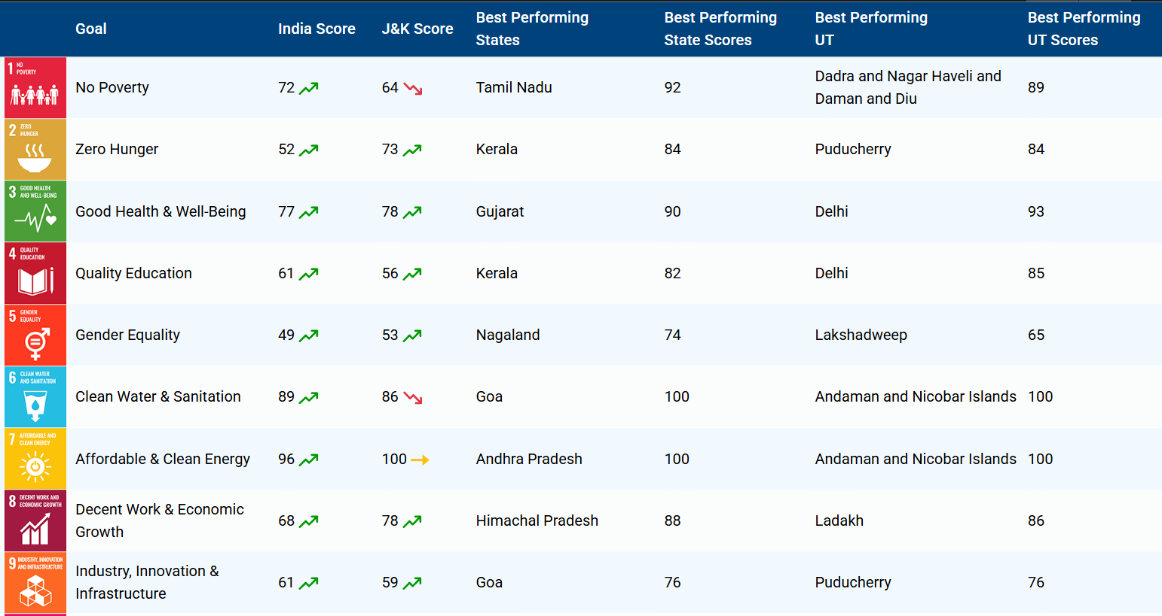
Table displaying the Goal wise comparison data for current year.

Slide 24
5. Viewing of the OOMF Tab

Slide 25
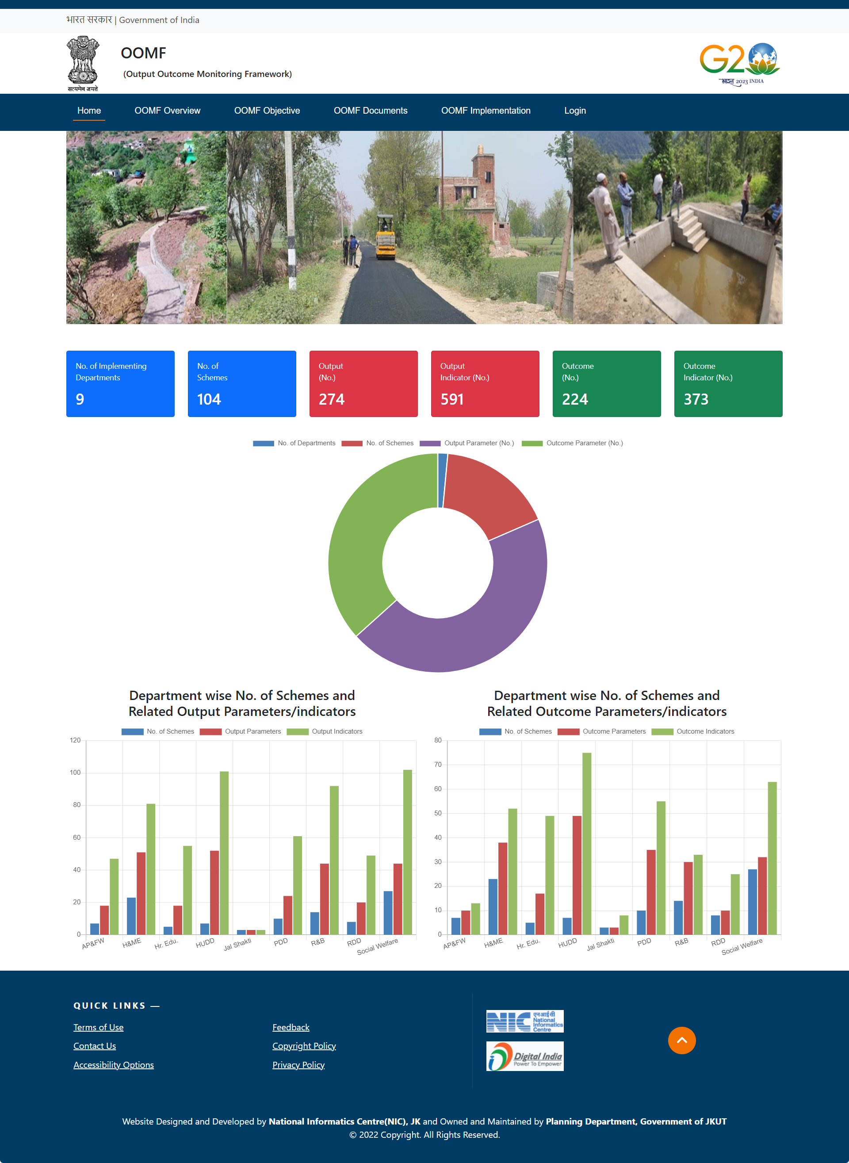
Click on OOMF (Interlinking of Budget with SDGs) from sidebar to view this page.

Slide 26
6. Viewing of the Analysis & Interpretation Tab

Slide 27
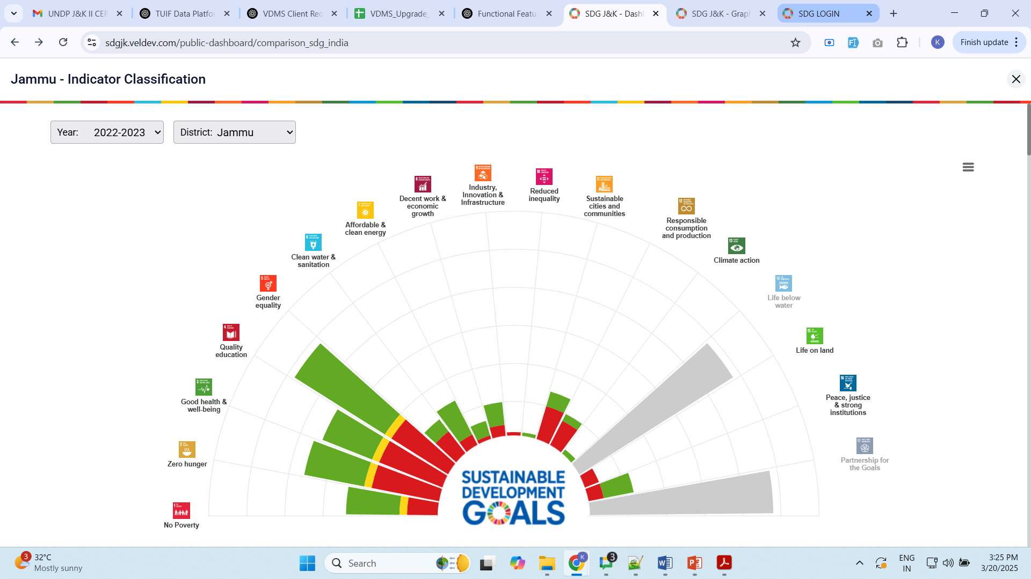
Click on the Analysis & Interpretation tab to view below page.
Change the district & Year from here.

Slide 28
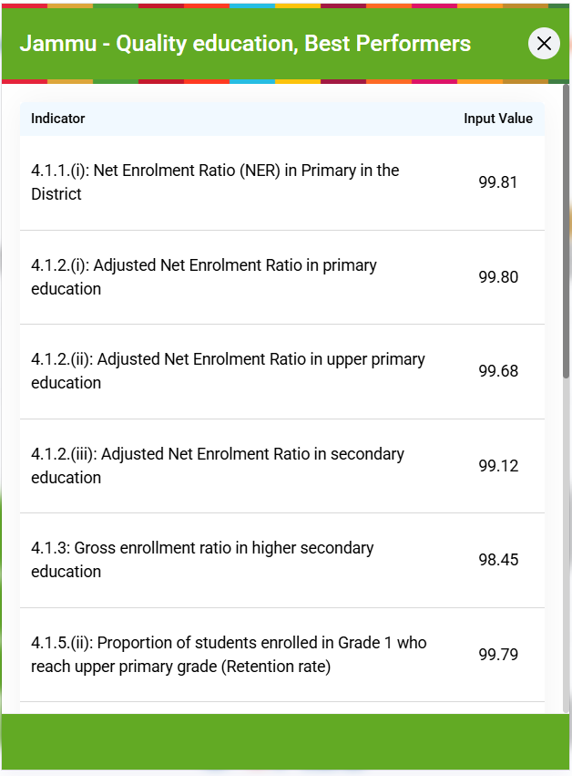
Click on the highlighted category of any goal to view the Indicator Classification.
Click here to view Indicator Classification of this category.

Slide 29
7. Viewing of the NITI Aayog Page

Slide 30
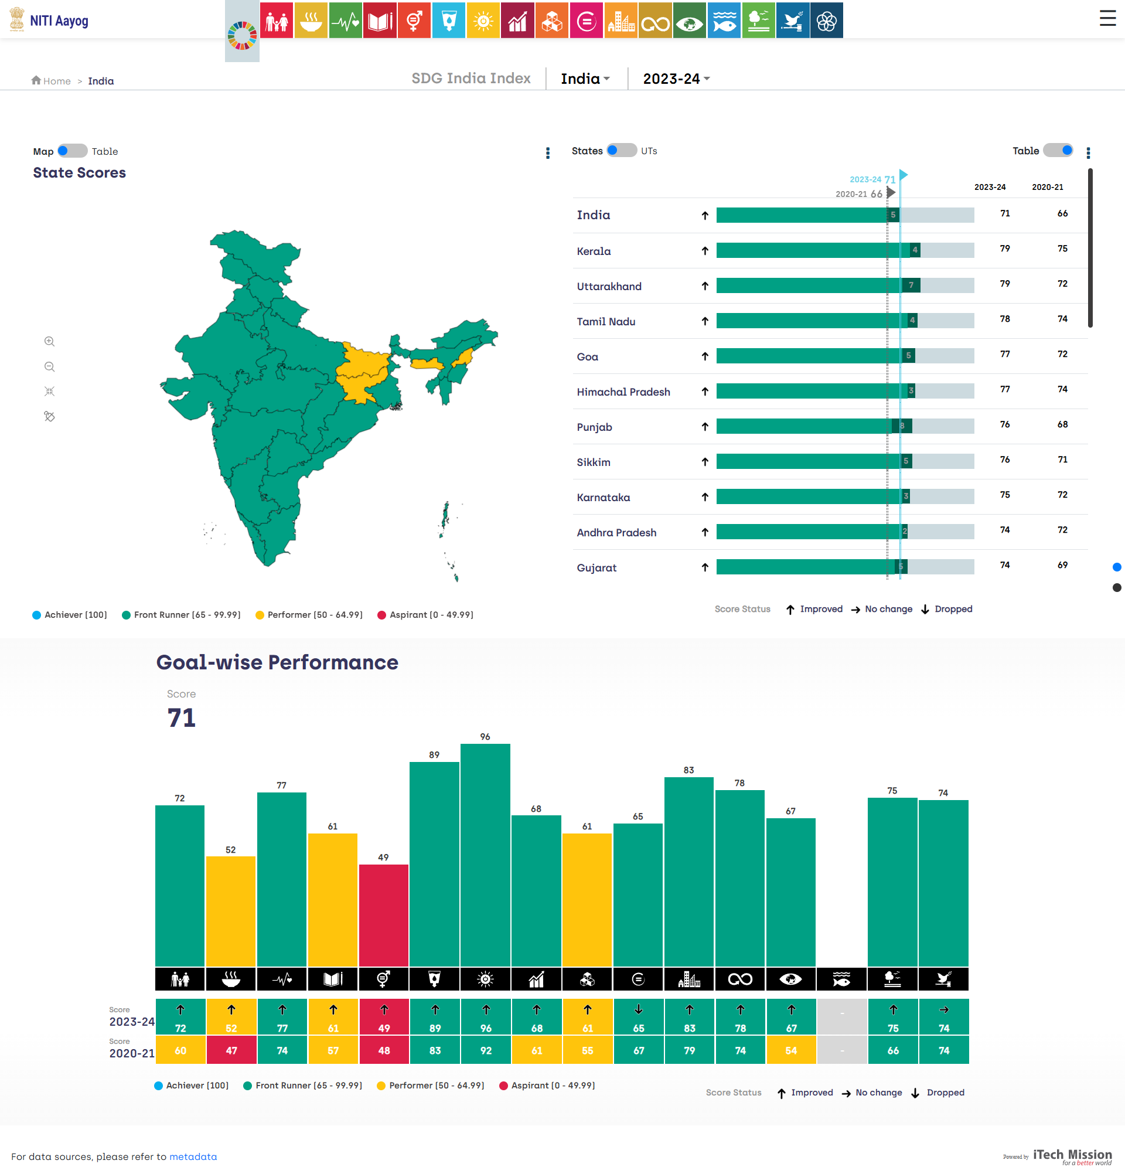
Click on NITI Aayog from sidebar to view this page.

Slide 31
8. Other Page Navigation

Slide 32
8.0.1. About Us Page

Slide 33
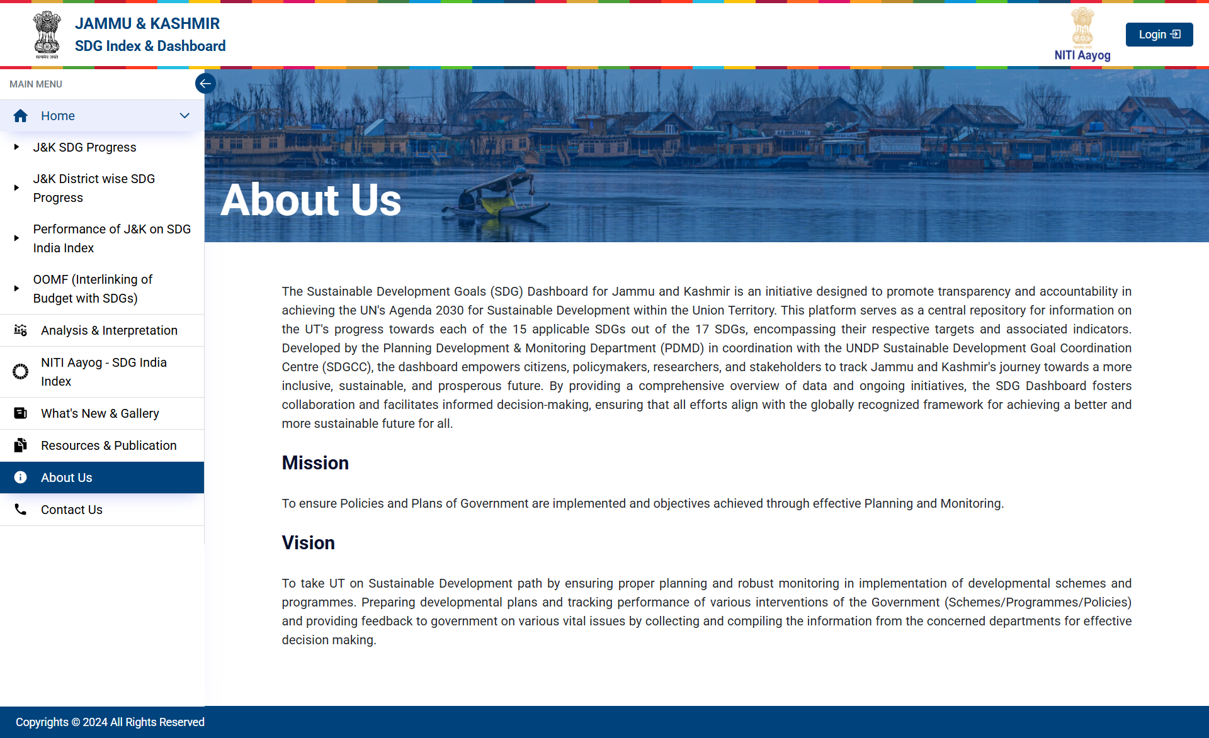
Click on About Us from sidebar to view About Us page.
Click here to view About Us Page.

Slide 34
8.0.2. Resources & Publications Page

Slide 35
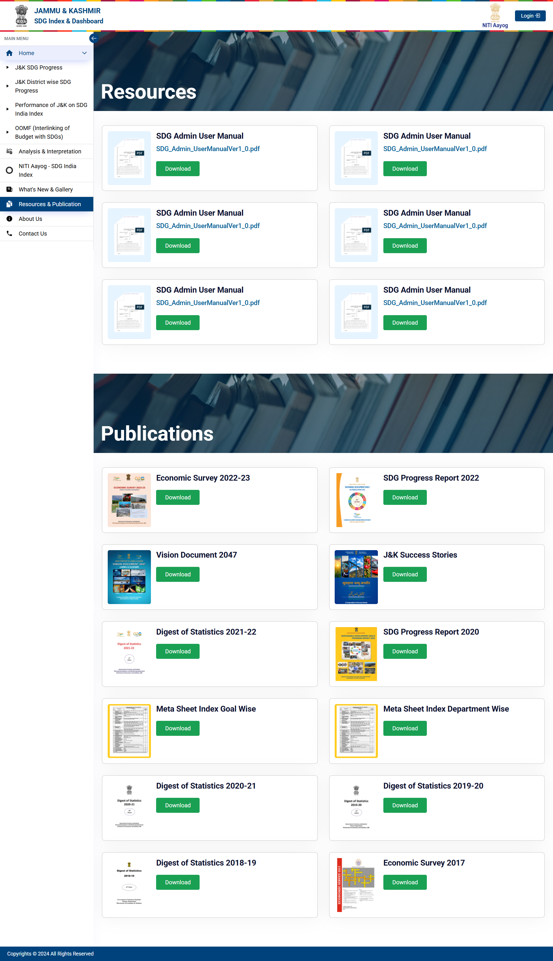
Click on Resources & Publications from sidebar to view this page.
Click here to view Resources & Publications Page.
Click here to Download.

Slide 36
8.0.3. News and Events Page

Slide 37
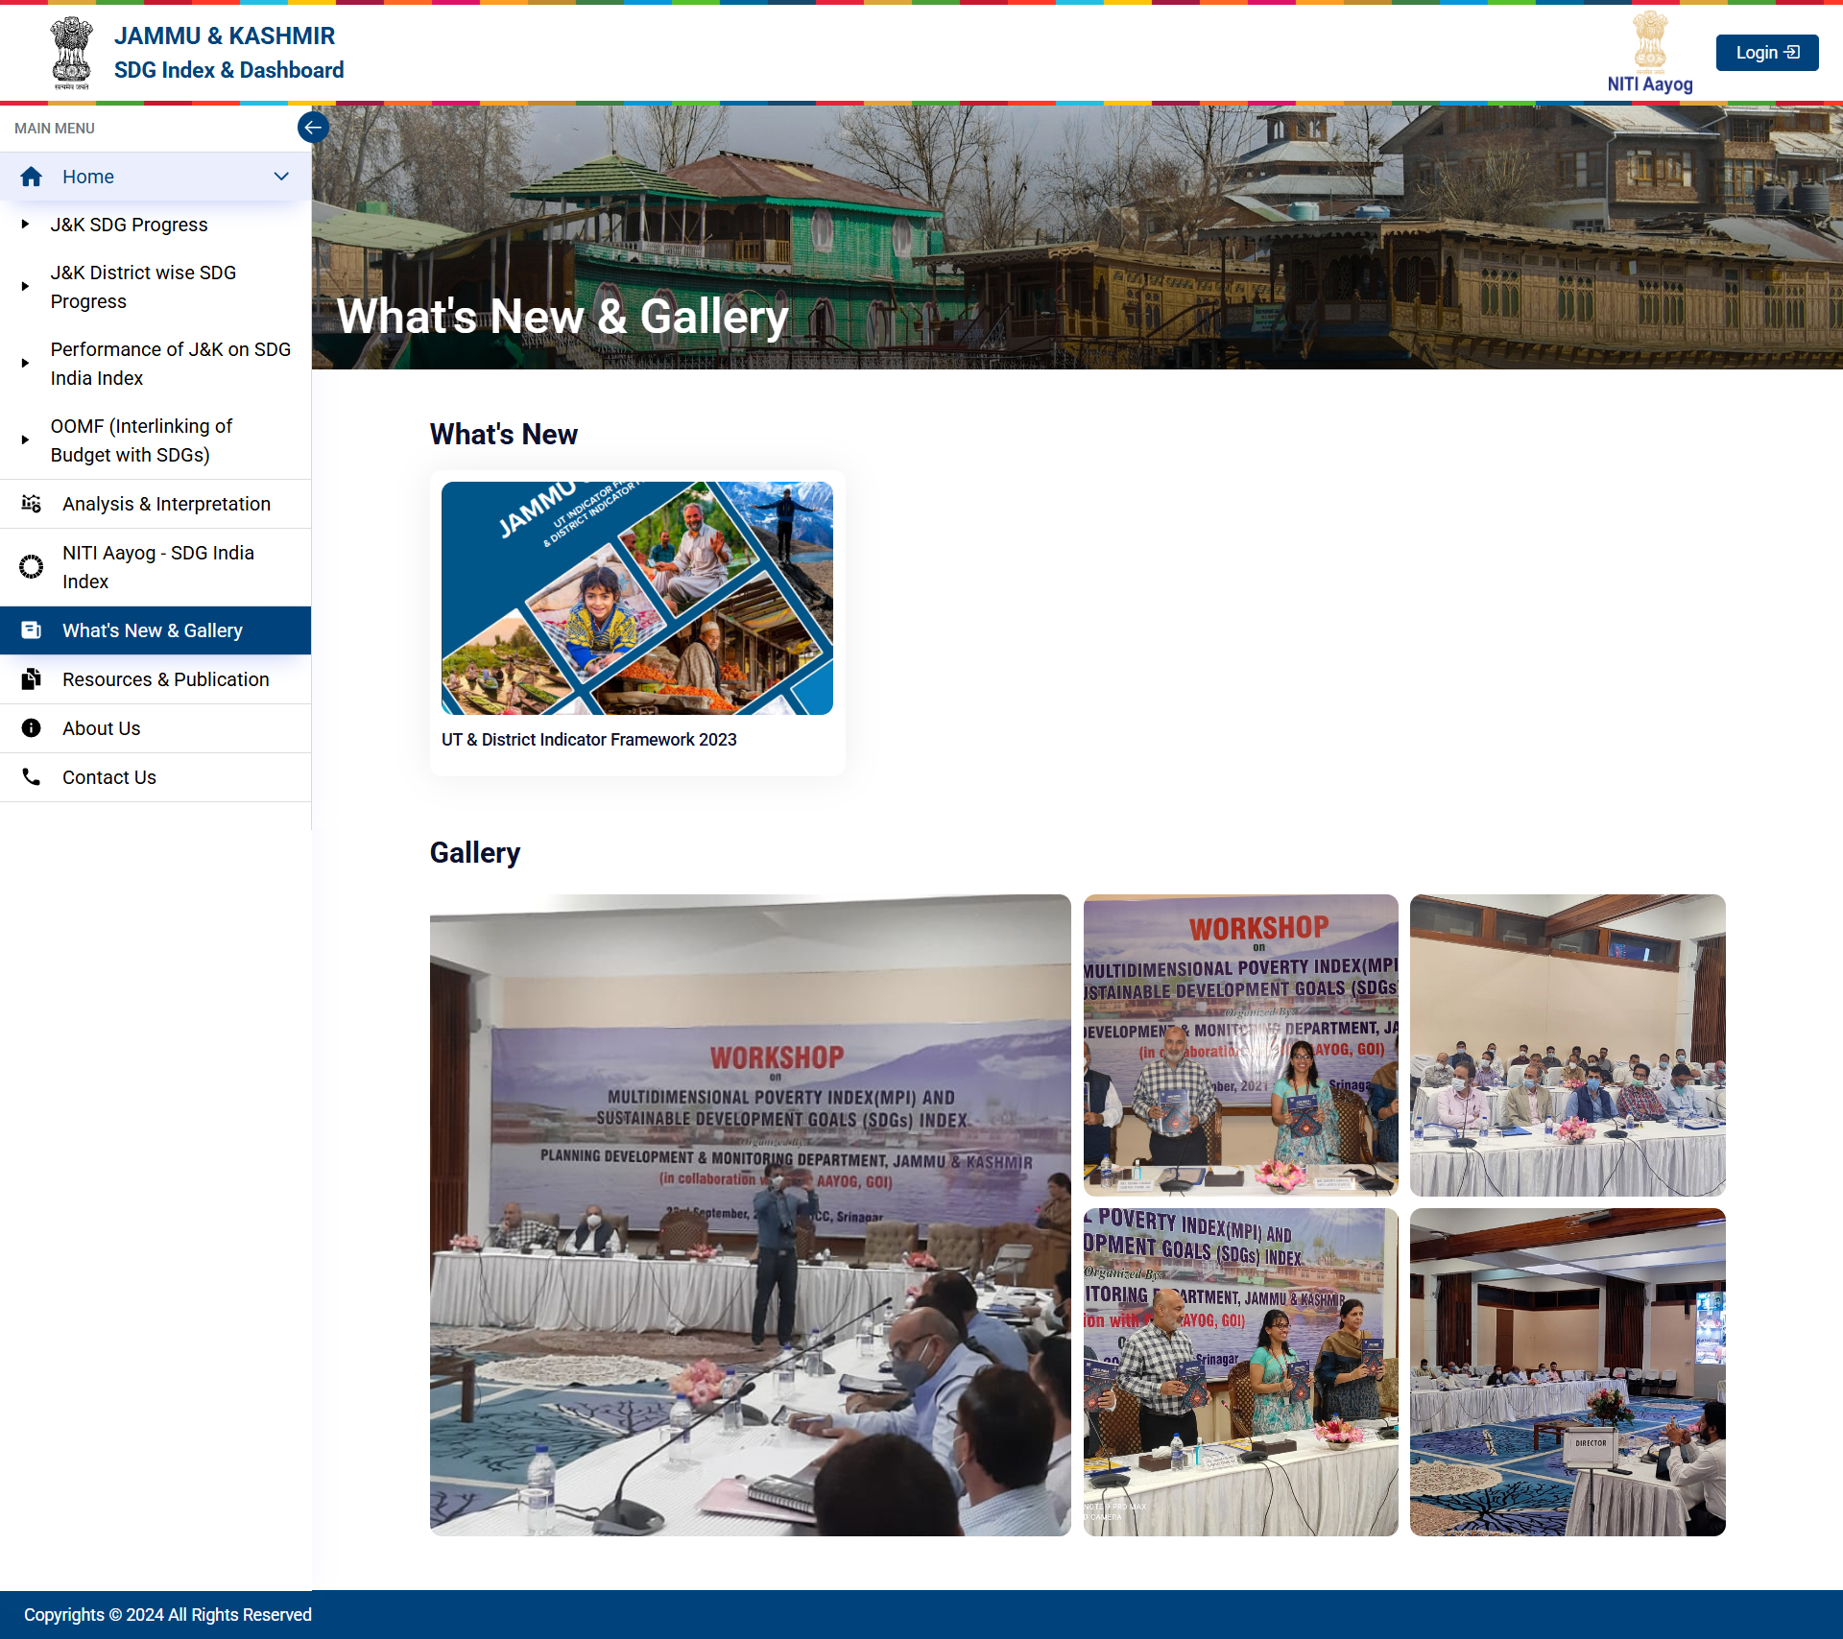
Click on What’s News & Gallery from sidebar to view this page.
Click here to view What’s New & Gallery Page.

Slide 38
8.0.4. Contact Us Page

Slide 39
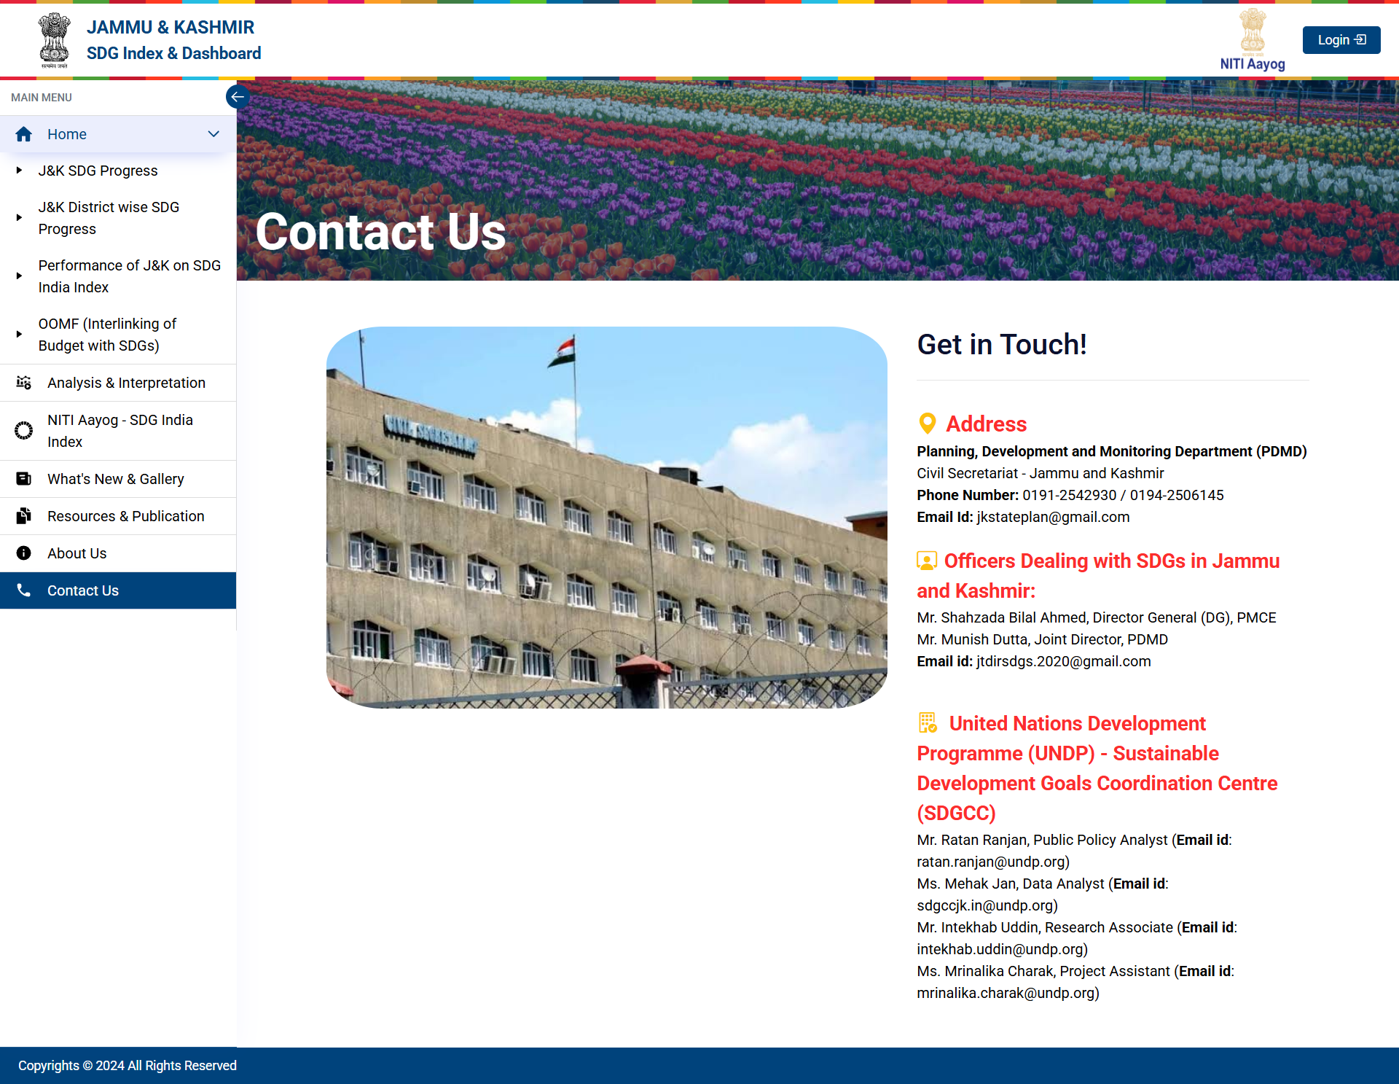
Click on Contact Us from sidebar to view Contact Us page.
Click here to view Contact Us Page.

Slide 40
Thank You

