Slide 1



SDG Indexing Dashboard
- Jammu and Kashmir
Backend
User Manual v0.1
Velocity Software Solutions Pvt. Ltd.
Address: E23, Sector 63, Noida, UP, India 201 301
Ph: +91120424 3310
Email: inquiry@velsof.com
Web: www.velsof.com

Slide 2
Agenda
Introduction…………………………………………….……3
Application Flow……………………………………………4
Adding an Indicator………………………..………………..7
Indicator Data Entries............................................................10
Approve or Disapprove Data Entry………………………...17
Exporting Reports…………………………………………..20
Managing Users & Roles..……………....………………….25
Dashboard Input…………………………………………….33
Masters Management.……………………………………....36
Enable and Disable Functionality…………………………..46
Exporting a File………………………...……...……………48
Advance Search Functionality………………………............50
Dashboard…………………………...……………………....52

Slide 3
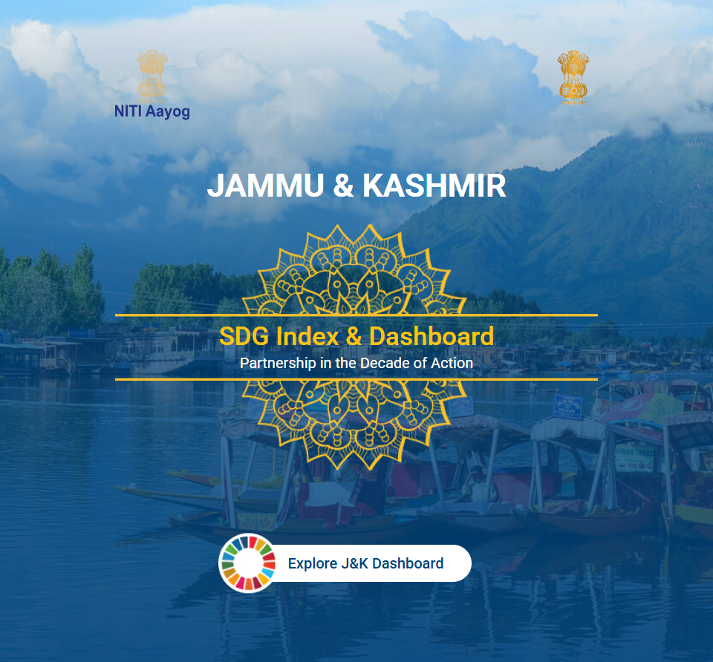
Introduction
The Jammu and Kashmir SDG Dashboard is a web-based platform for storing, tracking, monitoring, and reporting state-specific Sustainable Development Goals (SDGs) indicators. It enables to track SDG progress at various administrative levels, ensuring comprehensive reporting on achievements related to SDGs.
The dashboard comprises two components:
Public Dashboard for transparent access to SDG progress.
User Dashboard with detailed insights for authorized users.

Slide 4
Application Flow

Slide 5
User Roles
Admin
District Entry User
District Approver User
Department Entry User
Department Approver User

Slide 6
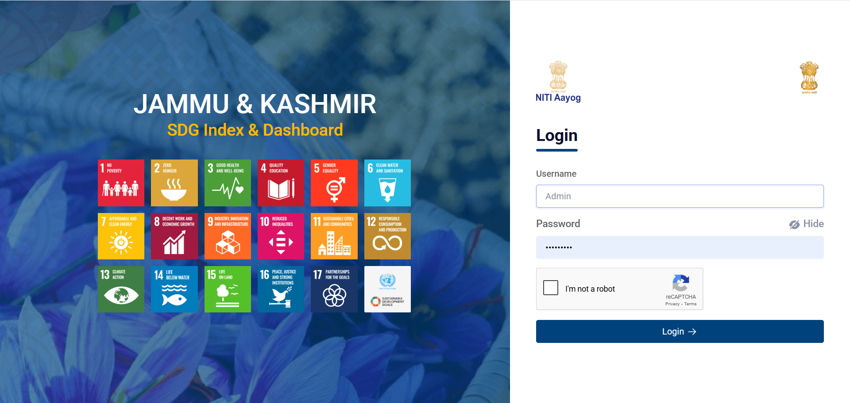
Enter correct credentials to log in the system.

Slide 7
1. How to add a new Indicator

Slide 8
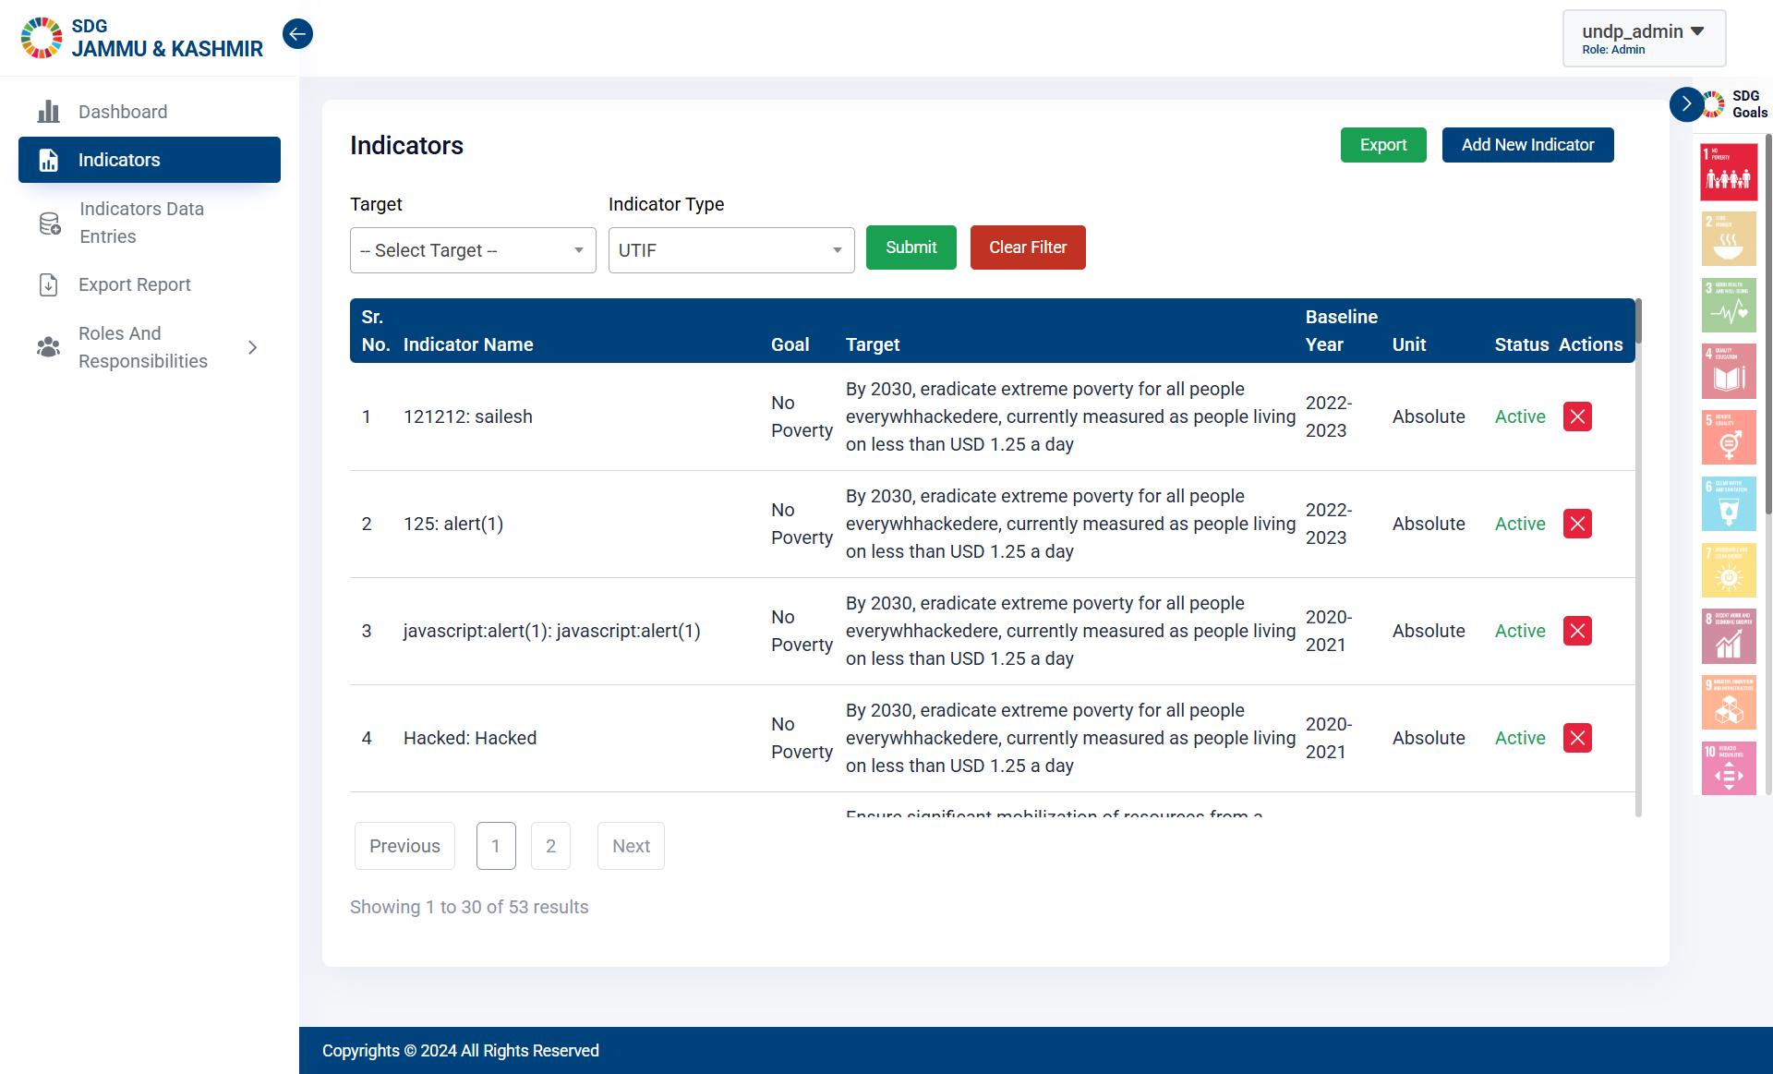
Step 1 - Click on Indicators on the Side Bar. Click on “Add New Indicator”.
Click here to Add New Indicator.
Click here to open the Indicator Page.

Slide 9
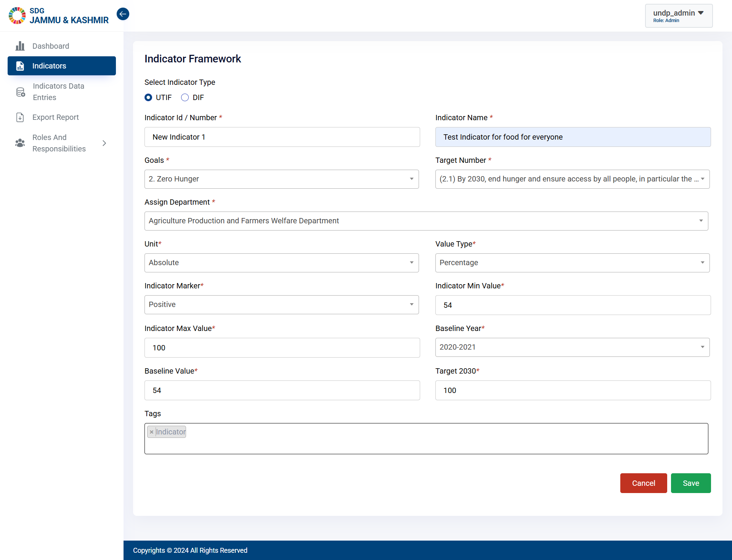
Step 2 - Once the form is filled, Click on “Save”.
Click here to Save Indicator.

Slide 10
2. How to enter the Indicator Data Values

Slide 11
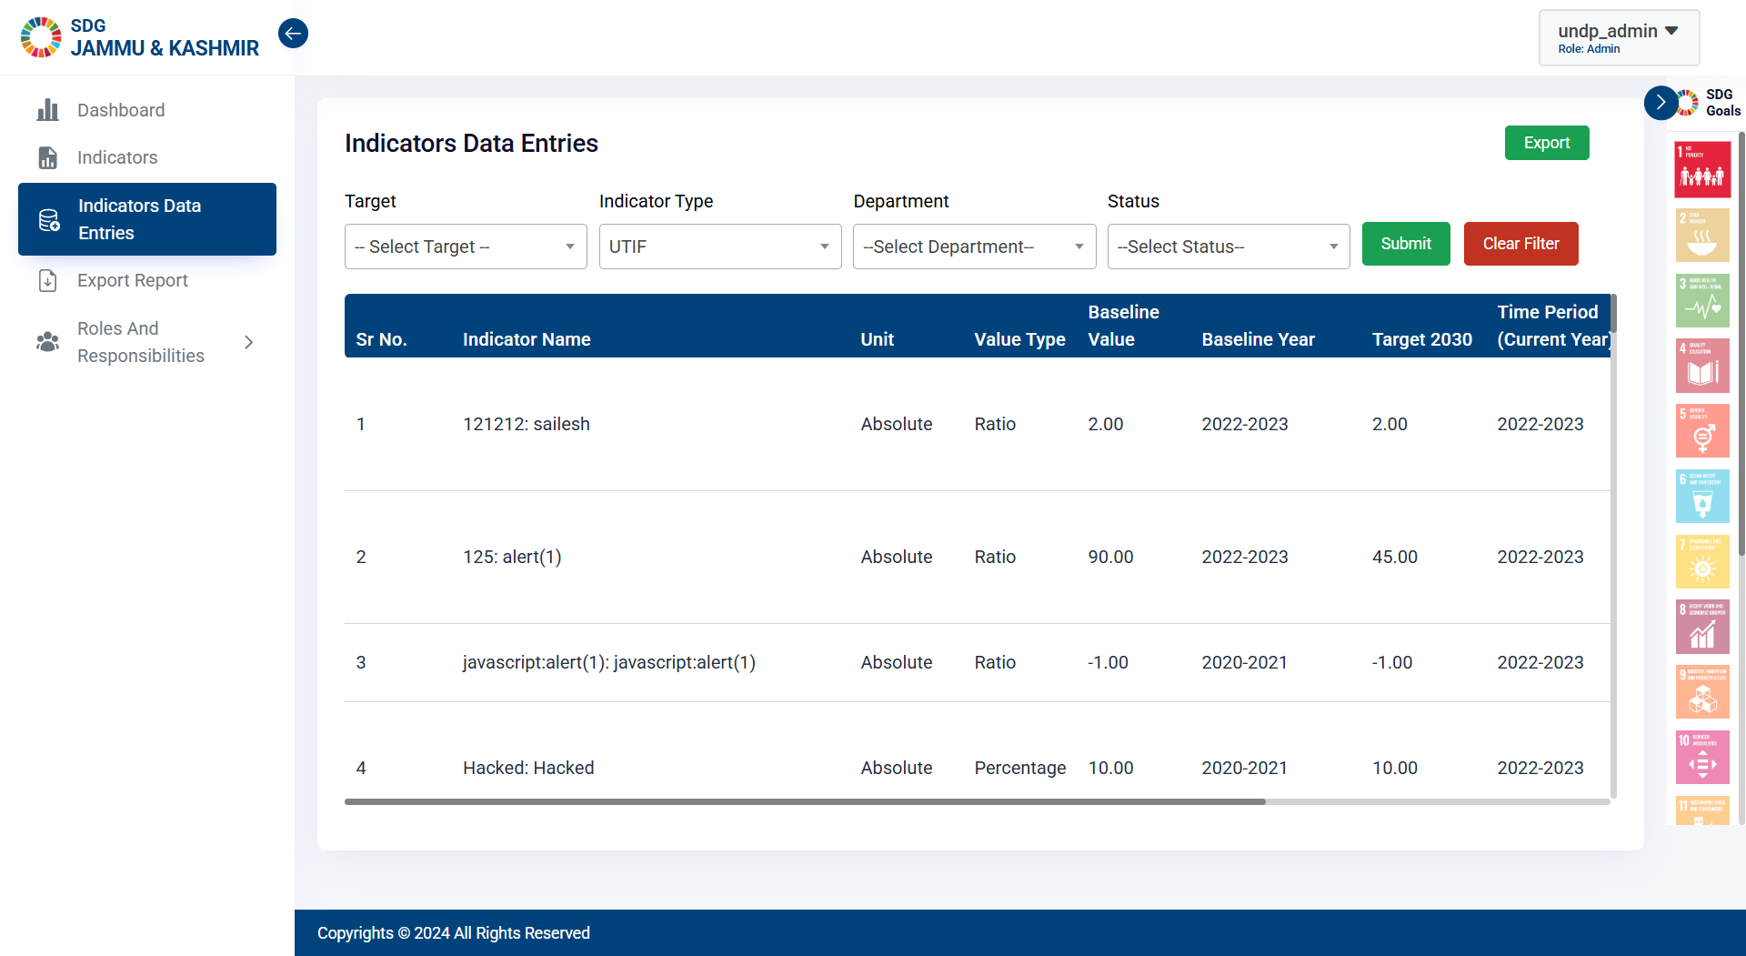
Step 1 - Click on Indicators Data Entry on the Side Bar.
Click here to open the Indicators Data Entry Page.

Slide 12
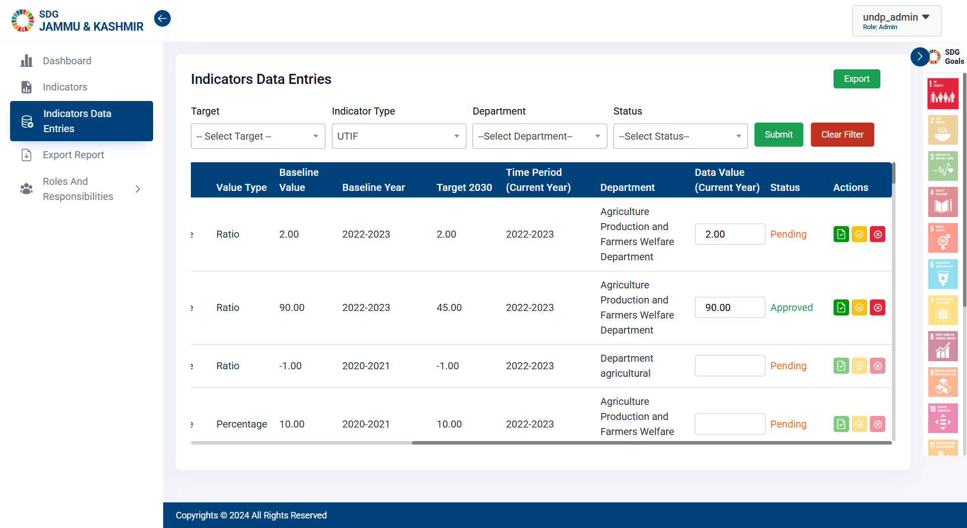
Step 2 - Enter the Data Value from here.
Apply filters from here.
Click here to save the Data Value.

Slide 13
3. How to do Bulk Indicator Data entry

Slide 14
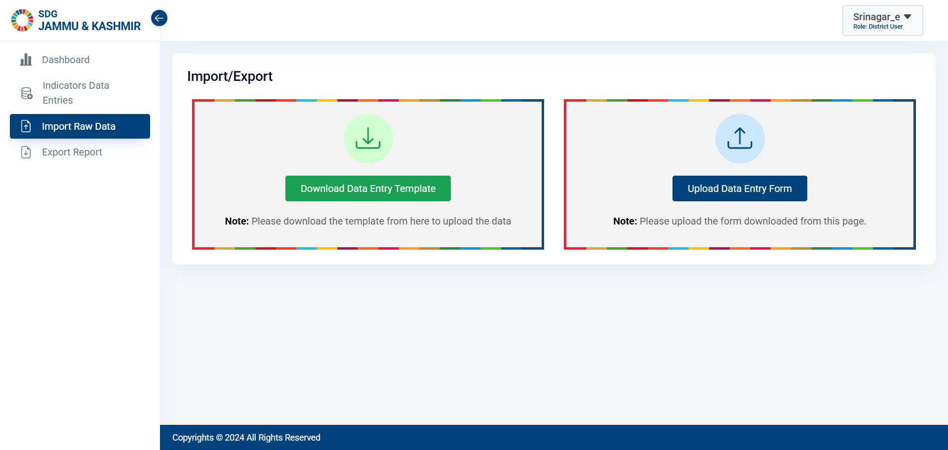
Step 1 - Click on Indicators Data Entry on the Side Bar.
Click here to download the Data Entry Template.

Slide 15
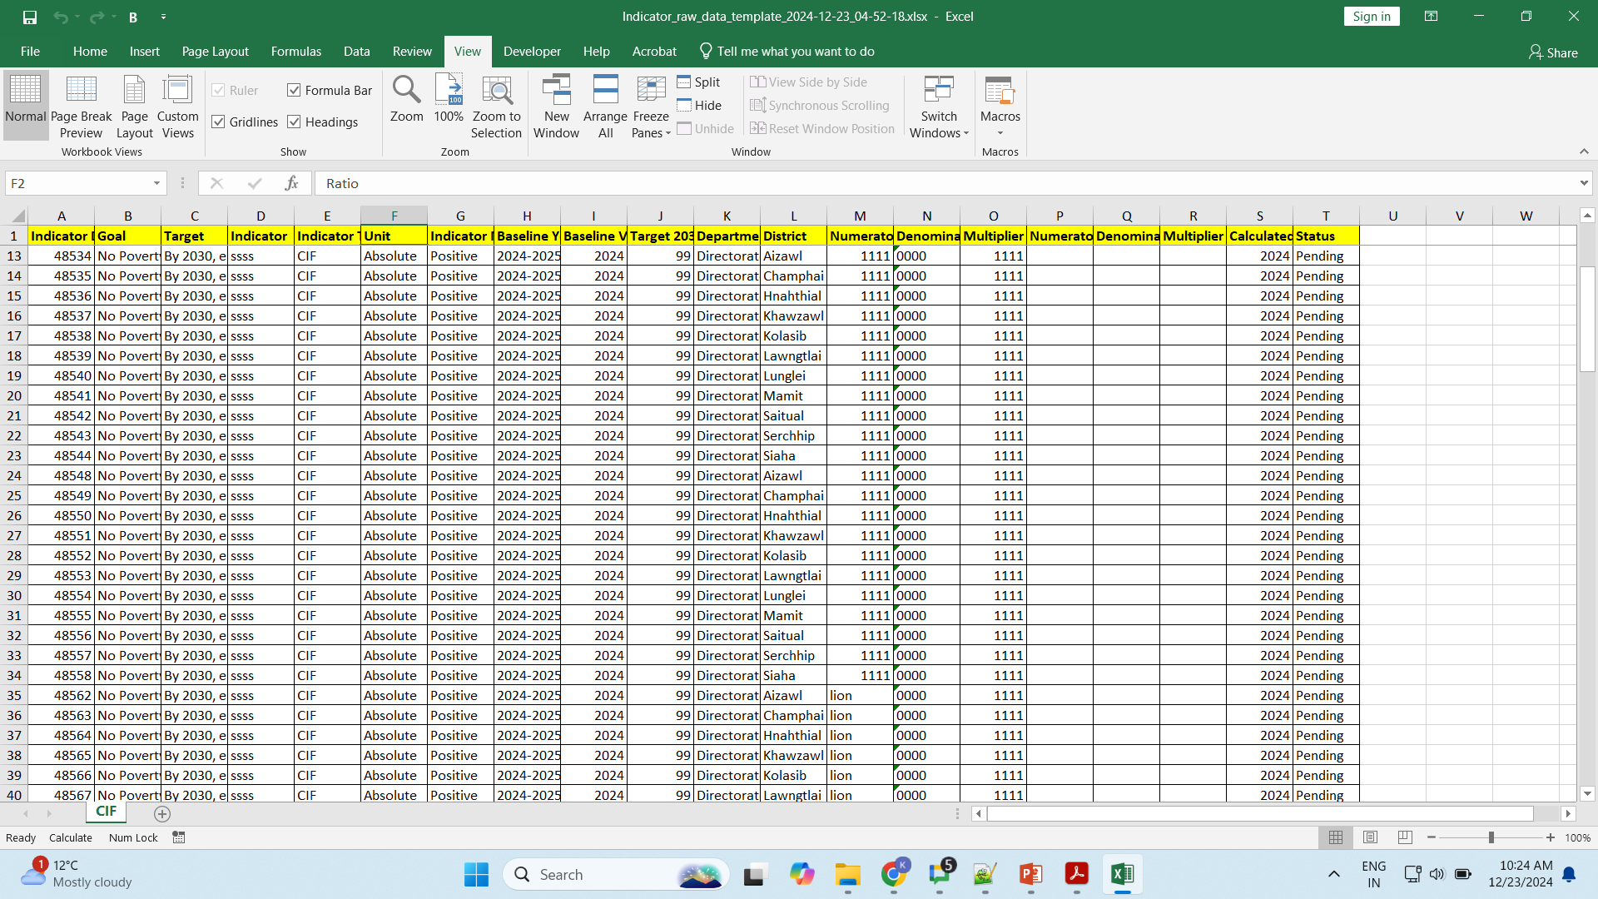
How to Fill the Downloaded Sheet?
Enter the data in the downloaded sheet.

Slide 16
Step 2 - Fill the Data values and Upload the Indicators Data Sheet.
Click here to upload the Data Entry Template.

Slide 17
4. How to Approve or Disapprove the Indicator Entry

Slide 18
Step 1 - Click on Approve button to Approve the entry values.
Click here to Approve.

Slide 19
Step 1 - Click on Disapprove button to reject the approval of the entry values.
Click here to Disapprove.

Slide 20
5. How to Export Indicator Report

Slide 21
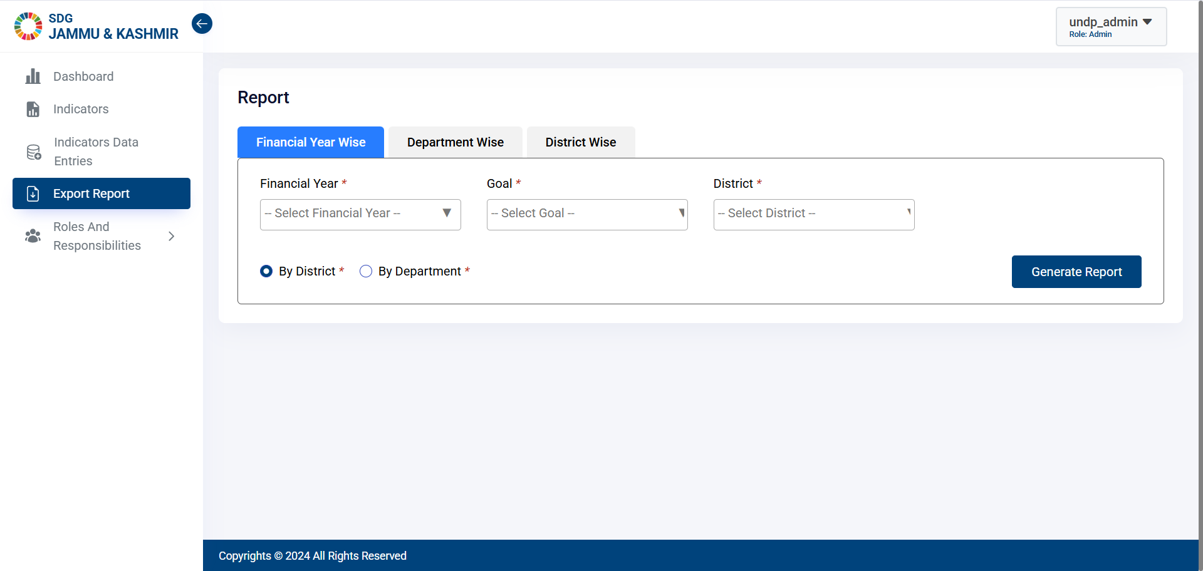
Step 1 - Click on Export Report on the Side Bar.
Click here to view Export Reports Page.

Slide 22
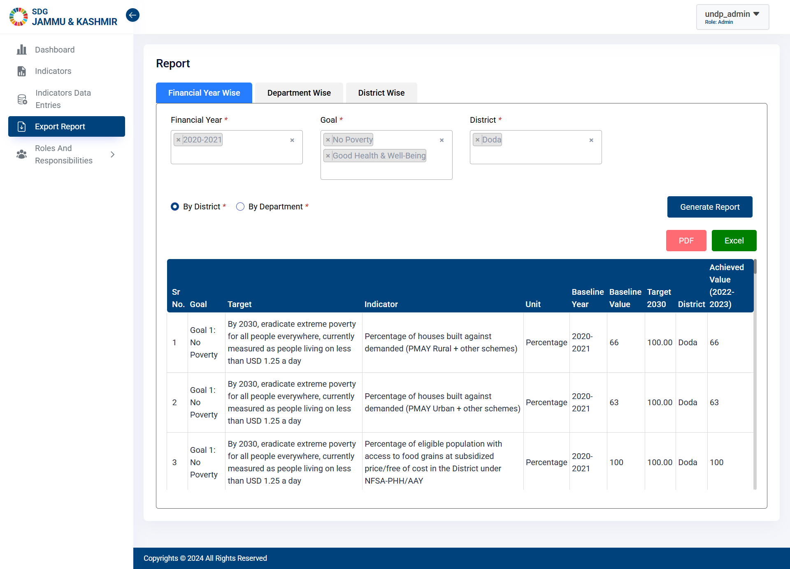
Step 2 - Select the required fields and Click on “Generate Report”.
Click here to generate report.

Slide 23
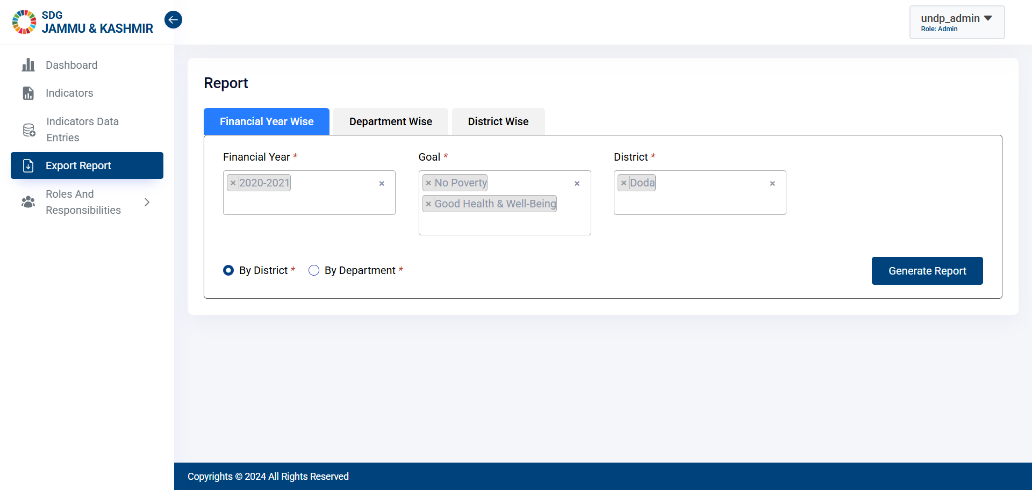
Click on the Report Type Name to Switch the Report Type.
Click here to change the report type.

Slide 24
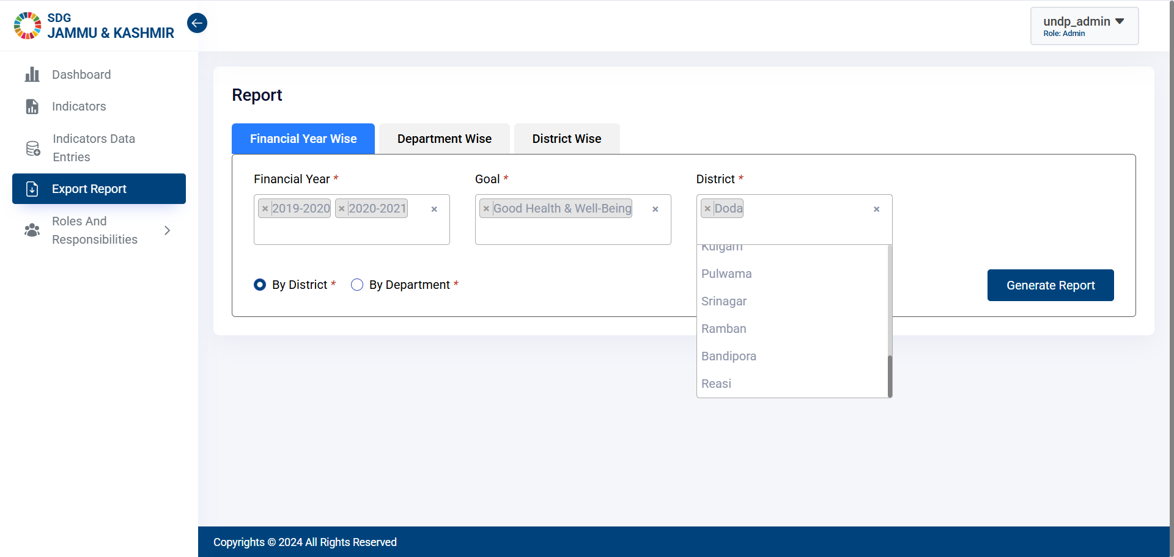
Select multiple Years, Districts and Goal for which you want to generate the report.
Click here to select one or more goals.

Slide 25
6. How to create New Users

Slide 26
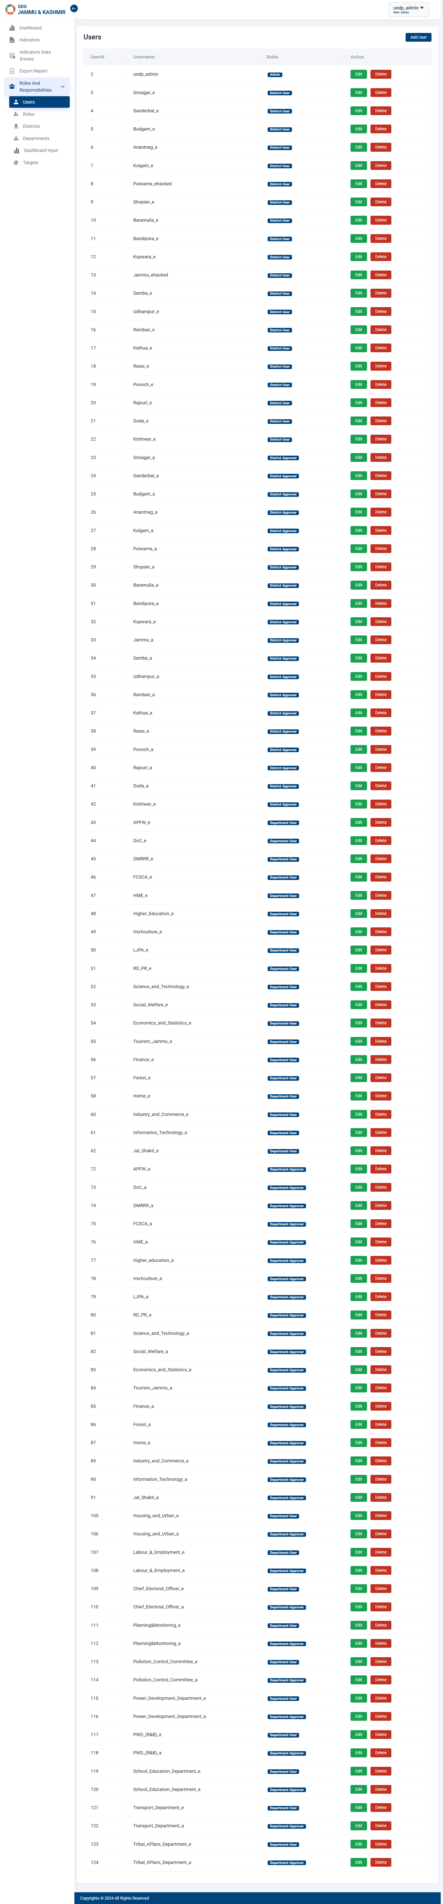
Step 1 - Click on Roles & Responsibilities and then click on Users on the Side Bar.
Click here to open Users Page.

Slide 27
Step 2 - Click on “Add User”.
Click here to open.
Click here to Edit or Delete User.

Slide 28
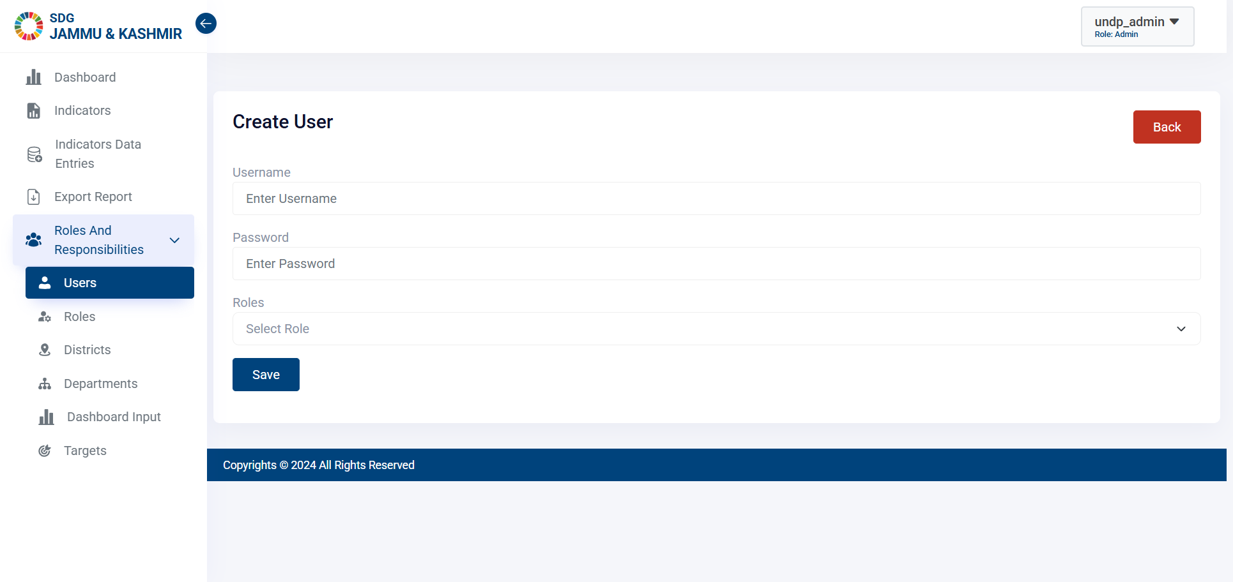
Step 3 - Add the details and Click on “Save”.
Click here to add new User.

Slide 29
7. How to Edit Role’s Permissions

Slide 30
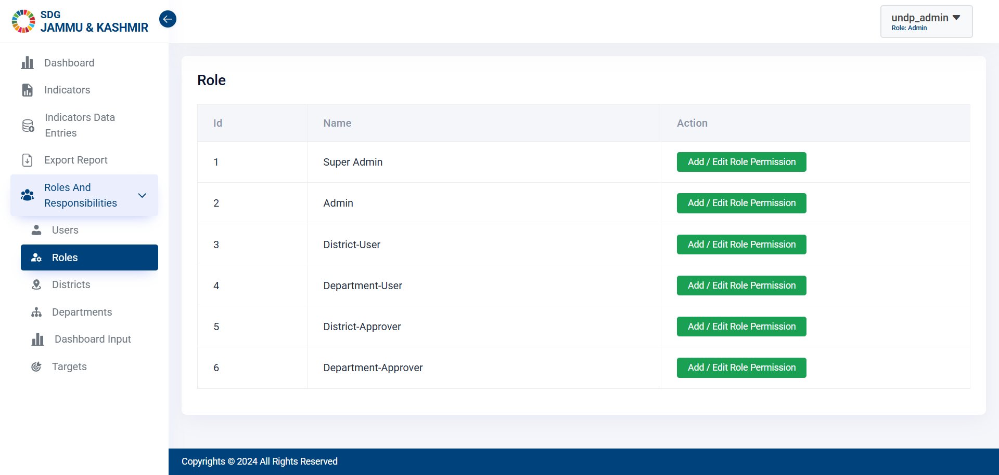
Step 1 - Click on Roles & Responsibilities, select Roles from the Side Bar.
Click here to open Roles Page.

Slide 31
Step 2 - Click on “Add/Edit Role Permission” button.
Click here to edit roles permission Page.

Slide 32
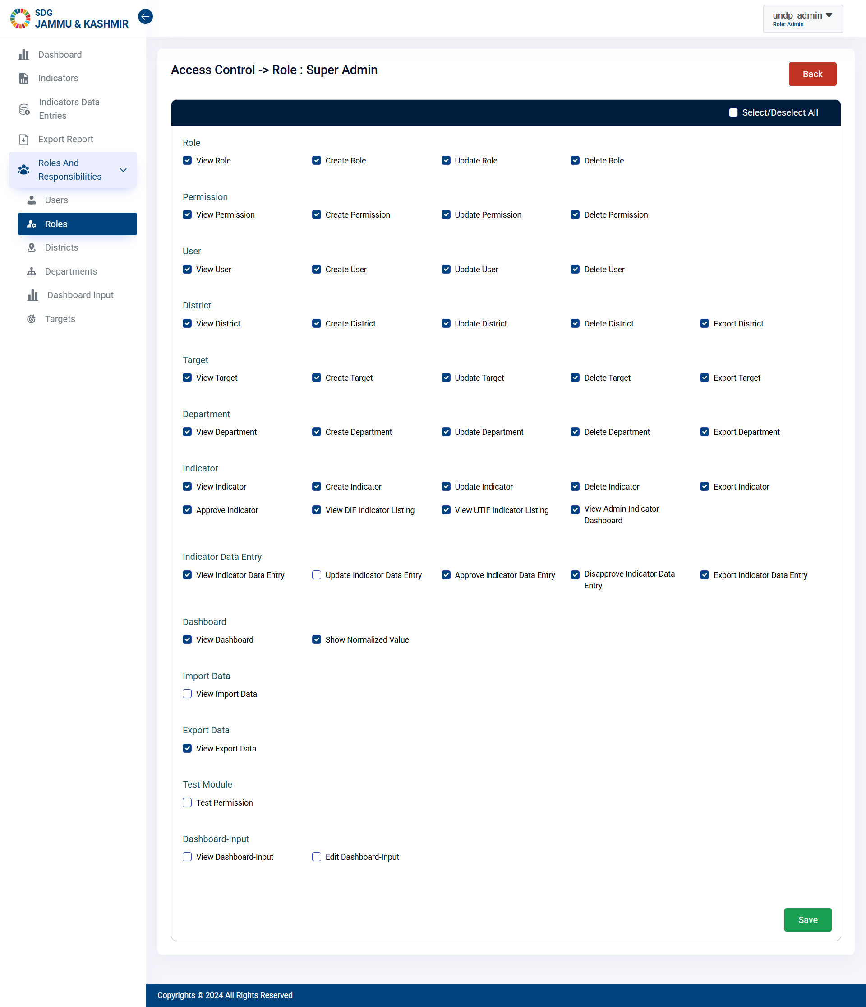
Step 3 – Select the permissions and Click on “Save”.
Click here to save.

Slide 33
8. How to do Dashboard Input

Slide 34
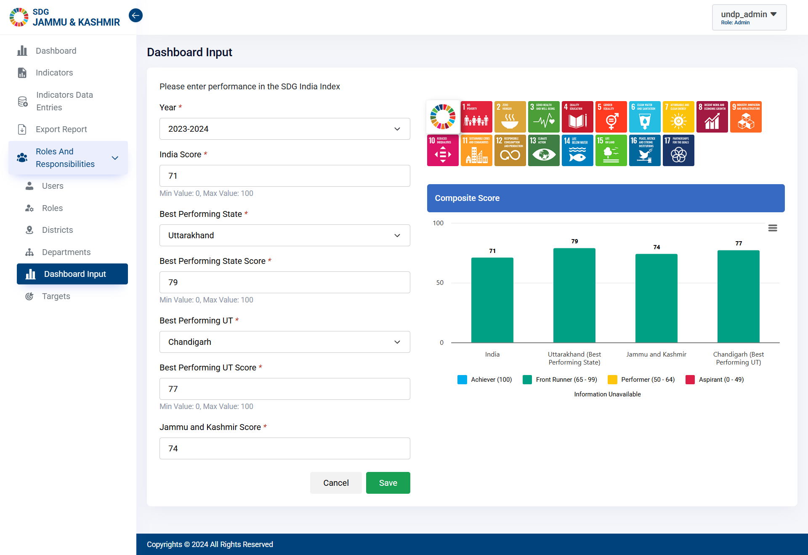
Step 1 - Click Roles & Responsibilities, select Dashboard Input on the Side Bar.
Click here to open Dashboard Input page.

Slide 35
Step 2 – Add or Edit the comparison data and Click on “Save”.
Enter the data and click on save.

Slide 36
9. How to add new District

Slide 37
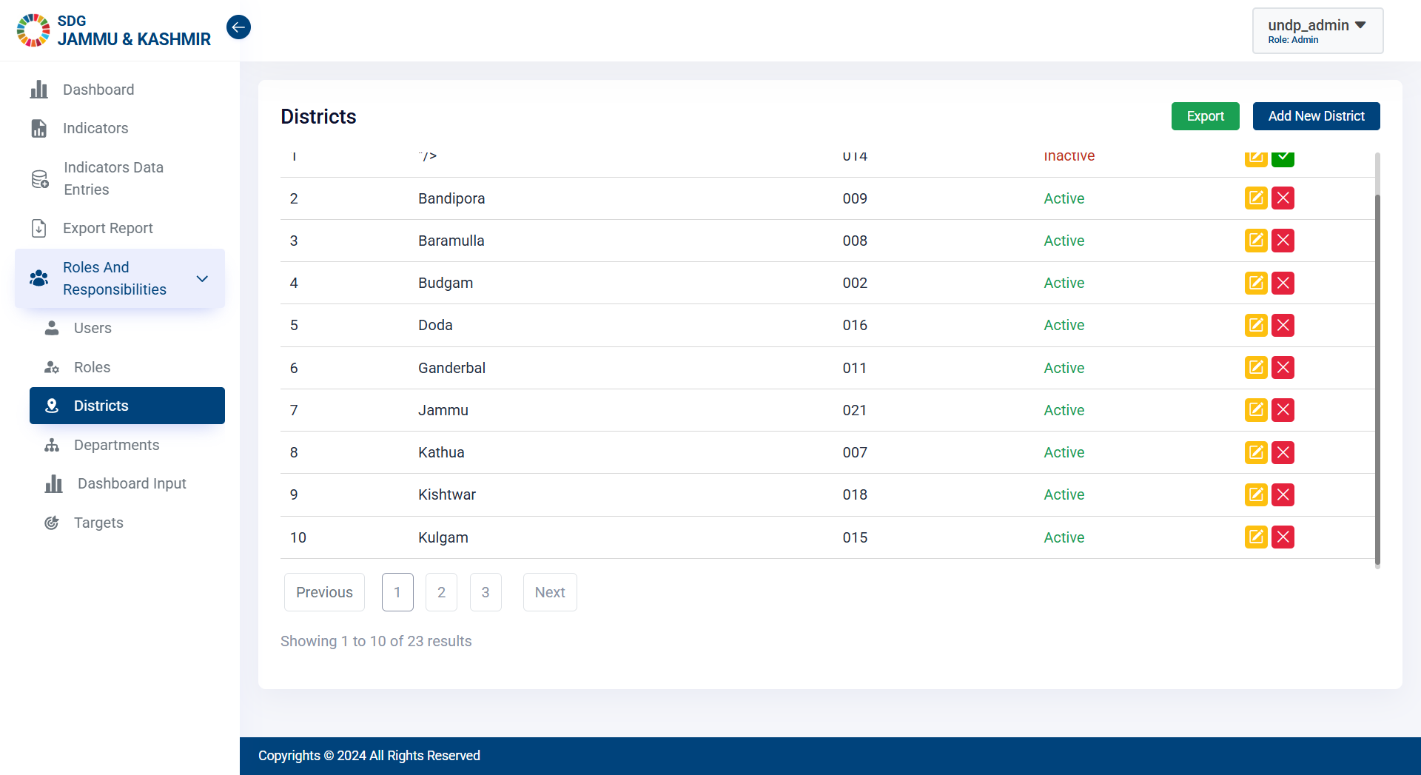
Step 1 - Click on Roles & Responsibilities, select District on the Side Bar.
Click here to open Districts Page.

Slide 38
Step 2 - Click on “Add New District”.
Click here to add new District.

Slide 39
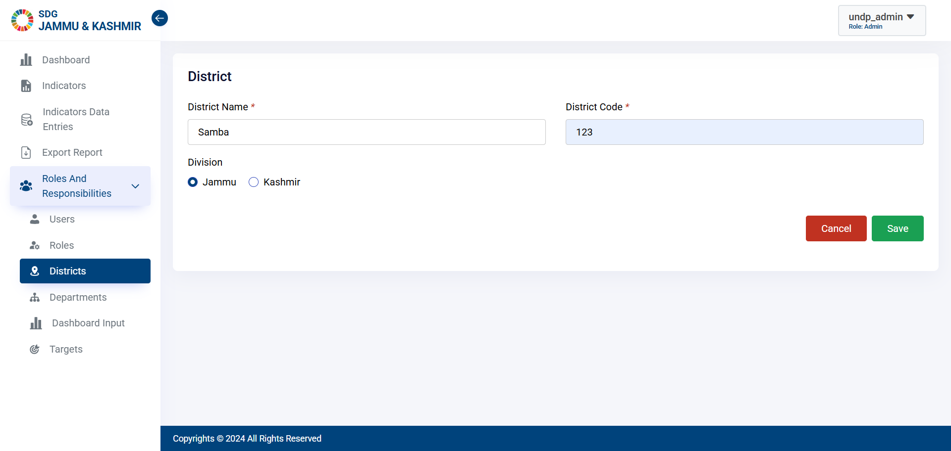
Step 3 - Enter the details and Click on “Save”.
Click here to add new District.

Slide 40
10. How to add new Department

Slide 41
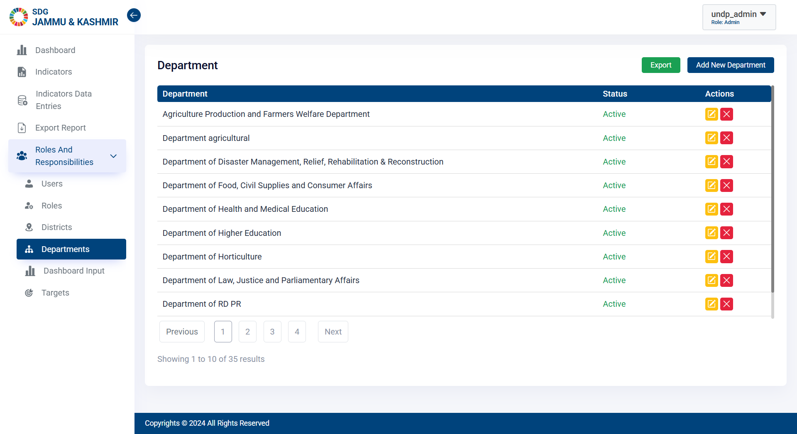
Step 1 - Click on Roles & Responsibilities, select Departments on the Side Bar.
Click here to open ULB Page.

Slide 42
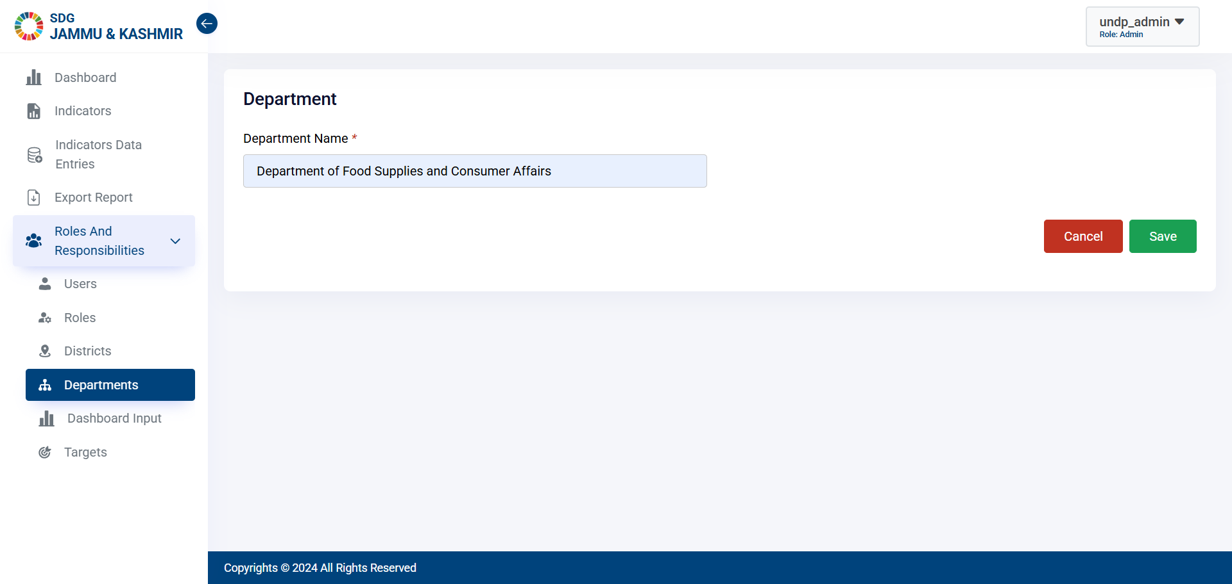
Step 2 - Click on “Add New Department”. Enter name and Click on “Save”.
Click here to add new Department.

Slide 43
11. How to add new Target

Slide 44
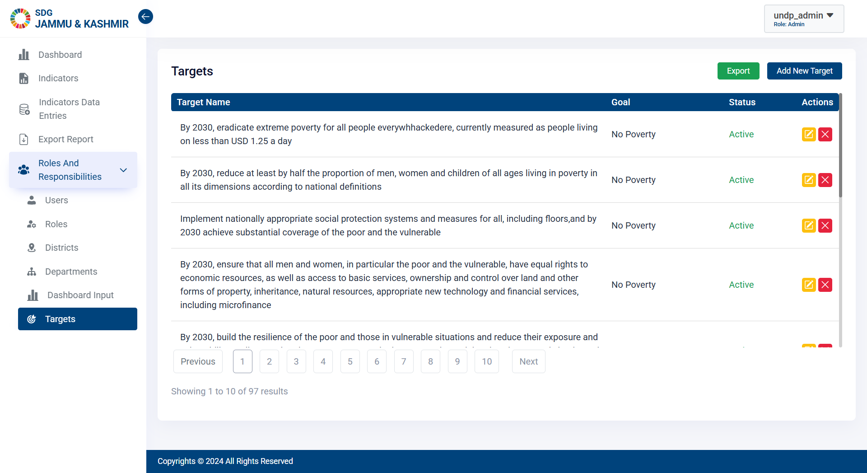
Step 1 - Click Roles & Responsibilities, select Targets on the Side Bar.
Click here to open Targets page.

Slide 45
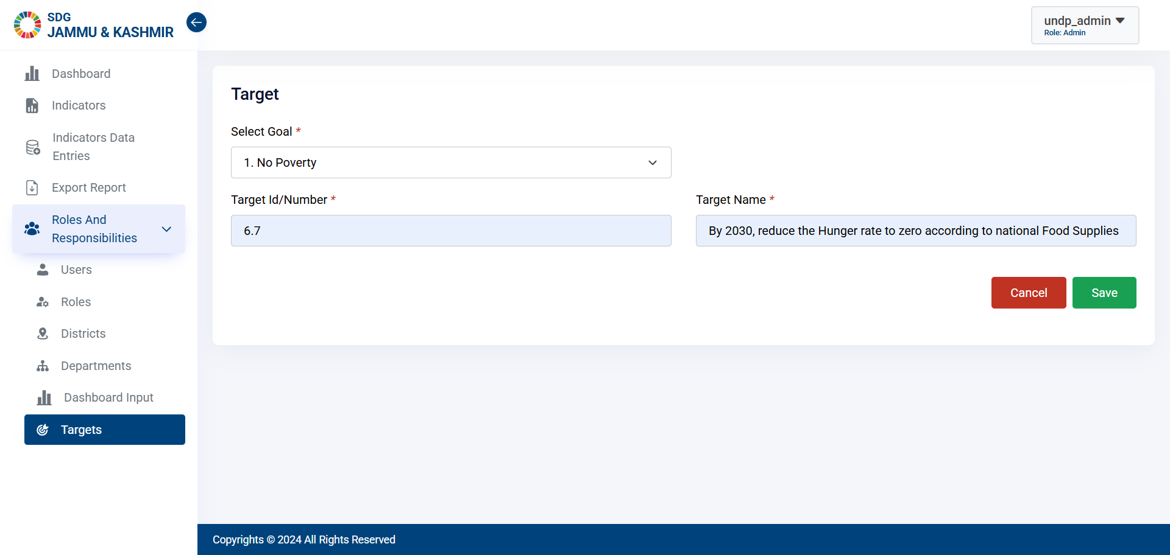
Step 2 - Click on “Add New Target”.
Click here to add Target.

Slide 46
12. Enable and Disable Functionality

Slide 47
To Enable or Disable, Click on “Enable” or “Disable” button.
Click here to toggle.

Slide 48
13. File Export

Slide 49
Click on “Export” to export the data.
Click here to export the list.

Slide 50
14. Advance Search Functionality

Slide 51
Enter the Keyword and Click here to Search.
Apply filters and to desired data
Apply goal filters from here.

Slide 52
15. Dashboard

Slide 53
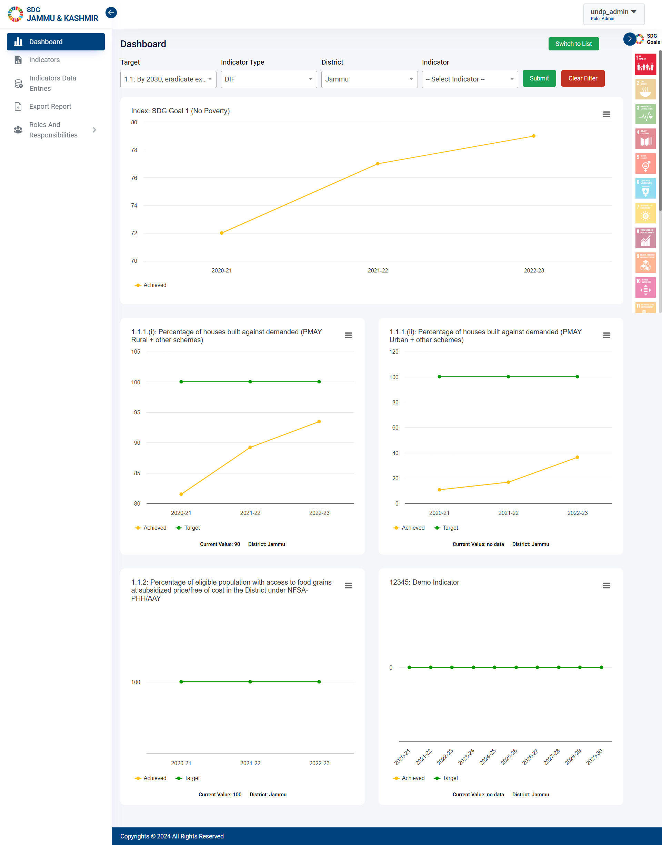
Click on the Dashboard to view.
Click here to open Dashboard.

Slide 54
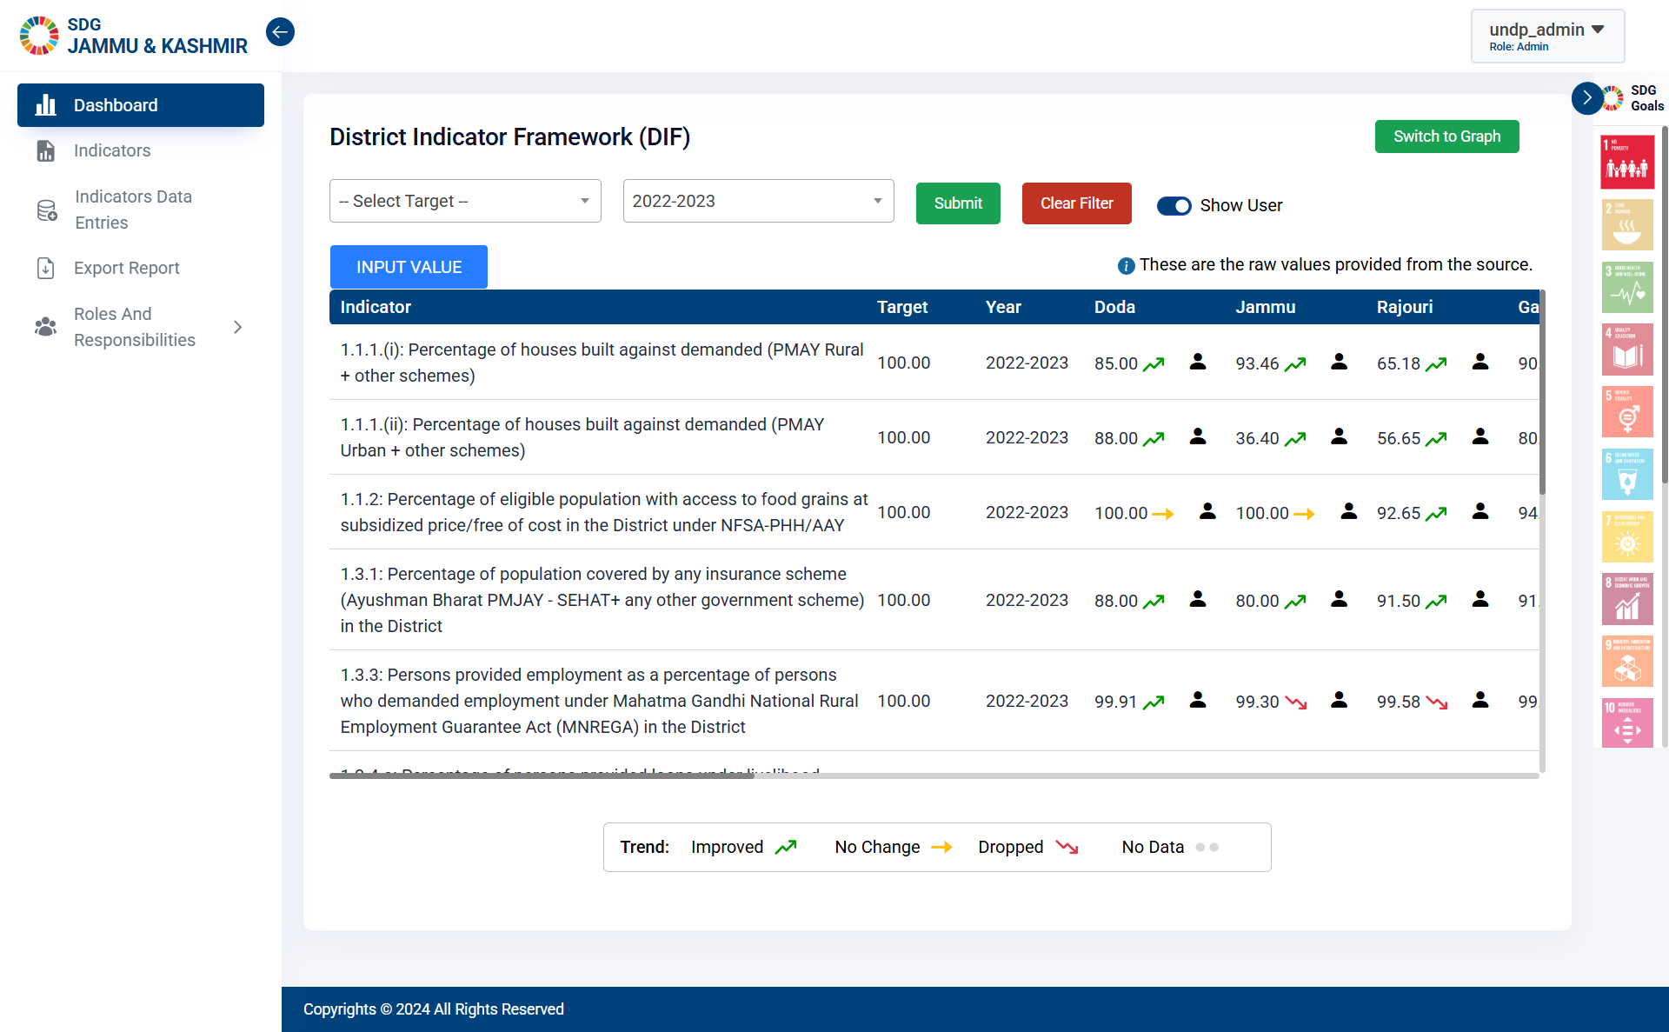
Click on Theme to view the Theme Dashboard.
Click here to switch to List.

Slide 55
Thank You

